Slide 1


Wi-Drone: Wi-Fi-based 6-DoF Tracking for Indoor Drone Flight Control
Guoxuan Chi*, Zheng Yang*, Jingao Xu*, Chenshu Wu†, Jialin Zhang*,
Jianzhe Liang*, Yunhao Liu‡
* School of Software and BNRist, Tsinghua University
† Department of Computer Science, The University of Hong Kong
‡ Global Innovation Exchange, Tsinghua University
Presenter: Kun Qian
University of California San Diego
Notes:
(Opening…)
Hi everyone, I’m Kun Qian from UCSD.
Due to the travel restriction in China, the authors cannot be here in person, so I’ll be the proxy presenter of this paper: Wi-Drone: Wi-Fi-based six-degree-of freedom tracking for indoor drone flight control.

Slide 2
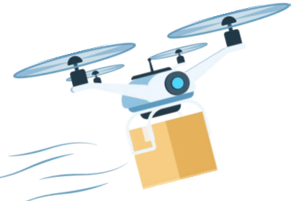
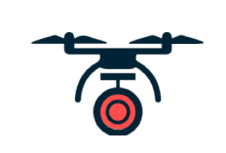
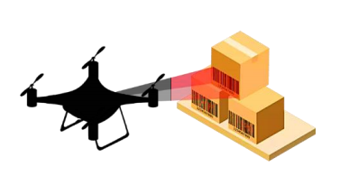




Drone-based Applications
Package Delivery
Security Monitoring
Inventory Management
Research report ^{[1]} shows:
The indoor drone market will grow by $29 billion by 2027;
With an annual growth rate of almost 20% ;
Most drone-based applications works in outdoor scenarios.
Drones are now entering indoors…
[1] Marketsand Markets, “Unmanned Aerial Vehicles (UAV) market,” 2019. [Online].
Notes:
Recent years have witnessed the advent of a wide range of drone-based applications, such as package delivery, security monitoring, inventory management, and so on.
[CLICK] During the past decade, most drone-based application study focuses on outdoor scenarios.
[CLICK] And now, it's time for drones and their applications to enter indoors.
[CLICK] Research reports show that the indoor drone market will grow by $29 billion by 2027, with an annual growth rate of almost 20%.
无人机具有广泛的应用前景，如包裹递送，安全监控，仓储管理等等。
[CLICK] 基于无人机的研究都主要集中于室外场景。
[CLICK] 现在，我们同时也不应该忽略无人机在室内场景的应用了。
[CLICK] 据估计，室内无人机应用的市场份额将于2027年达到290亿美元，每年规模增速高达20%。

Slide 3
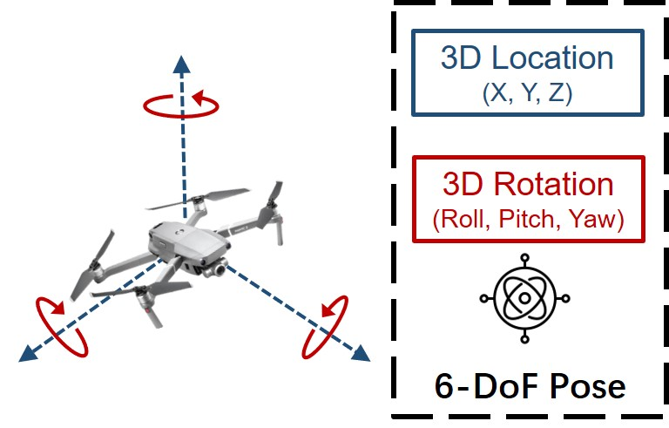
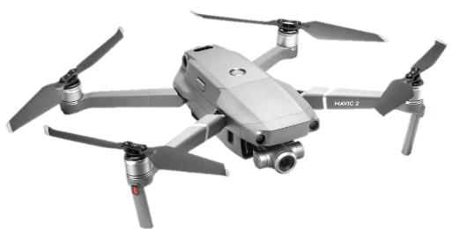
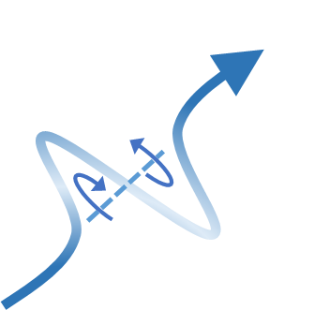
6-DoF Pose Tracking
Drone’s translation
6-DoF Trajectory
Drone’s rotation
Drone’s 6-DoF pose includes:
3-D translation, which means the location change;
3-D rotation, which means the orientation change;
Notes:
Six-degree-of-freedom (6-DoF) pose tracking is the core to support drone-based applications.
Specifically, during the flight, the drones may
[CLICK] change their 3D location
[CLICK] and 3D rotation,
[CLICK] forming a 6D trajectory.
[CLICK] Therefore, the 3D location and 3D rotation states are collectively referred to as the 6-DoF states.
Six-degree-of-freedom (6-DoF) tracking systems provide a drone with its real-time location and orientation in 3D space, realizing the drone's self-balancing, speed adjustment, and path planning.
6-DoF追踪技术正是支持无人机正常运行的关键。
具体来讲，我们知道无人机运行过程中会产生
[CLICK] 3D的位置变
[CLICK] 同时还会有3D的旋转变化。
[CLICK] 两类状态变化在飞行过程中共同作用，形成一条六自由度的轨迹
[CLICK] 因此，3D旋转和3D位置被统称作6-DoF状态
只有获取到无人机的实时姿态，才能保证无人机平稳与正常飞行，并在此基础上进一步执行各种各样的任务。

Slide 4
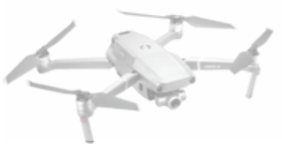
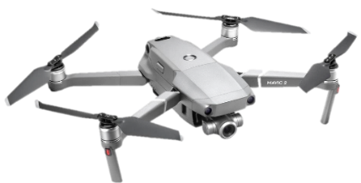

Existing 6-DoF Tracking Solutions
❓
Existing drone tracking solutions have their own limitations:
IMU-based solutions suffers from severe cumulative drift
GPS-based solutions can’t work in GPS-denied indoor scenarios
Vision-based solution can’t work in dark and texture-less scenarios
Lidar sensors are generally heavy, bulky, and expensive
IMU cumulative drift
X
GPS blockage
Notes:
Existing 6-DoF tracking solutions are various and tangled.
[CLICK] To start with, the inertial measurement unit (IMU) is widely adopted for drone flight control. However, IMU-based solutions suffer from severe cumulative drifts due to the hardware noise and the drone motor vibration.
[CLICK] The GPS-based solutions are widely used in outdoor scenarios, but are not applicable to GPS-denied indoor environments due to the signal blockage.
[CLICK] Vision-based solutions have been prevalent in recent years. However, this type of solution is highly dependent on the light and texture conditions, since the RGB cameras cannot work in the dark, and RGB-D cameras fail with glare and intense illumination.
[CLICK] LiDAR-based tracking is also not a good option. Because most LiDAR sensors are designed for automobiles, they are heavy, bulky, and expensive.
现有的应用与无人机的定位与追踪技术有很多，但都有着自身的不足之处。
[CLICK] 基于IMU的解决方案受到严重的累积漂移的影响；
[CLICK] 基于GPS的方案则由于遮挡，无法在室内环境使用；
[CLICK] 基于视觉的方案则难以在暗光和弱纹理场景下运行；、
[CLICK] 基于激光雷达的解决方案，则受限于激光雷达的重量、体积和价格，难以广泛应用在无人机上。

Slide 5
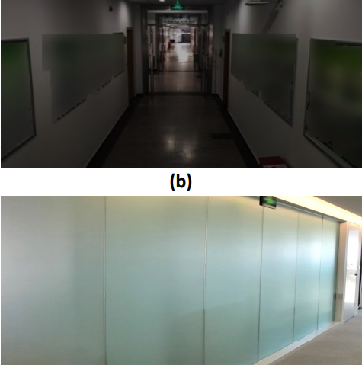


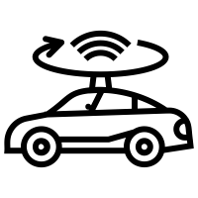

Existing 6-DoF Tracking Solutions
Existing drone tracking solutions have their own limitations:
IMU-based solutions suffers from severe cumulative drift
GPS-based solutions can’t work in GPS-denied indoor scenarios
Vision-based solution can’t work in dark and texture-less scenarios
Lidar sensors are generally heavy, bulky, and expensive
X
X
Dark and texture-less scenes
X
Heavy and bulky LiDAR
GPS blockage
Notes:
Existing 6-DoF tracking solutions are various and tangled.
[CLICK] To start with, the inertial measurement unit (IMU) is widely adopted for drone flight control. However, IMU-based solutions suffer from severe cumulative drifts due to the hardware noise and the drone motor vibration.
[CLICK] The GPS-based solutions are widely used in outdoor scenarios, but are not applicable to GPS-denied indoor environments due to the signal blockage.
[CLICK] Vision-based solutions have been prevalent in recent years. However, this type of solution is highly dependent on the light and texture conditions, since the RGB cameras cannot work in the dark, and RGB-D cameras fail with glare and intense illumination.
[CLICK] LiDAR-based tracking is also not a good option. Because most LiDAR sensors are designed for automobiles, they are heavy, bulky, and expensive.
现有的应用与无人机的定位与追踪技术有很多，但都有着自身的不足之处。
[CLICK] 基于IMU的解决方案受到严重的累积漂移的影响；
[CLICK] 基于GPS的方案则由于遮挡，无法在室内环境使用；
[CLICK] 基于视觉的方案则难以在暗光和弱纹理场景下运行；、
[CLICK] 基于激光雷达的解决方案，则受限于激光雷达的重量、体积和价格，难以广泛应用在无人机上。

Slide 6

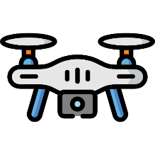


Wi-Fi-based 6-DoF Tracking
Wi-Fi-based 6-DoF tracking solutions benefit from the following aspects:
Wi-Fi-based tracking take AP as the anchor, and therefore free of cumulative drift
Radio signal is agnostic to illumination change, robust to visual interference
In many indoor scenarios, Wi-Fi APs have been pervasively deployed
Wi-Fi-based solution is light weight in terms of computation overhead and hardware cost
Free of cumulative drift
ü
ü
Robust to visual interference
Notes:
The above-mention limitations inspire us to build a Wi-Fi standalone 6-DoF tracking system for indoor drone flight control. Compared with existing methods, a Wi-Fi-based solution benefits from the following aspects:
1. [CLICK] Wi-Fi-based tracking system takes the access point (AP) as the anchor and thus
is free of the cumulative drift.
2. [CLICK] Besides, the Wi-Fi signal is agnostic to either illumination change, and robust to visual interference.
3. [CLICK] Additionally, Wi-Fi infrastructures have been pervasively deployed in most indoor scenarios, making Wi-Fi a ubiquitous solution for indoor device tracking.
4. [CLICK] And we all know that a Wi-Fi-based solution is also considerably lightweight regarding computation overhead, hardware cost, and payload weight.
而我们的想法，则是希望能够利用普遍的Wi-Fi信号，进行设备的6-DoF追踪。
这种方案有以下优势：
[CLICK] 首先，基于Wi-Fi的解决方案可以将AP作为锚点，从而避免累积漂移带来的影响；
[CLICK] 射频信号不会受到光照的影响，因此可以在暗光和弱纹理环境下运行；
[CLICK] Wi-Fi AP已经在大多数室内场景中被广泛部署，是的该方案具有普适性；
[CLICK] 此外，基于Wi-Fi的解决方案计算复杂度地，硬件开销成本小；

Slide 7


Wi-Fi-based 6-DoF Tracking
Wi-Fi-based 6-DoF tracking solutions benefit from the following aspects:
Wi-Fi-based tracking take AP as the anchor, and therefore free of cumulative drift
Radio signal is agnostic to illumination change, robust to visual interference
In many indoor scenarios, Wi-Fi APs have been pervasively deployed
Wi-Fi-based solution is light weight in terms of computation overhead and hardware cost
Pervasive deployment
Low cost
Notes:
The above-mention limitations inspire us to build a Wi-Fi standalone 6-DoF tracking system for indoor drone flight control. Compared with existing methods, a Wi-Fi-based solution benefits from the following aspects:
1. [CLICK] Wi-Fi-based tracking system takes the access point (AP) as the anchor and thus
is free of the cumulative drift.
2. [CLICK] Besides, the Wi-Fi signal is agnostic to either illumination change, and robust to visual interference.
3. [CLICK] Additionally, Wi-Fi infrastructures have been pervasively deployed in most indoor scenarios, making Wi-Fi a ubiquitous solution for indoor device tracking.
4. [CLICK] And we all know that a Wi-Fi-based solution is also considerably lightweight regarding computation overhead, hardware cost, and payload weight.
而我们的想法，则是希望能够利用普遍的Wi-Fi信号，进行设备的6-DoF追踪。
这种方案有以下优势：
[CLICK] 首先，基于Wi-Fi的解决方案可以将AP作为锚点，从而避免累积漂移带来的影响；
[CLICK] 射频信号不会受到光照的影响，因此可以在暗光和弱纹理环境下运行；
[CLICK] Wi-Fi AP已经在大多数室内场景中被广泛部署，是的该方案具有普适性；
[CLICK] 此外，基于Wi-Fi的解决方案计算复杂度地，硬件开销成本小；

Slide 8
Comparison of Different Methods
Sensors | Wi-Fi | IMU | Camera | LiDAR
Free-of-drift | ü | û | ü | ü
Dark | ü | ü | û | û
Texture-less | ü | ü | û | ü
Low-complexity | ü | ü | û | û
Light-weight | ü | ü | ü | û
Low-cost | ü | ü | ü | û
Wi-Fi-based solution has its unique advantages
It can be leveraged for indoor drone 6-DoF tracking.
Notes:
In a nutshell, we believe that a Wi-Fi-based solution has unique advantages in many aspects.
And Wi-Fi can be leveraged for indoor drone 6-DoF tracking.
总的来讲，通过对比多种解决方案，我们发现基于Wi-Fi的解决方案具有他独特的优势，使其可以被用于室内无人机的6-DoF追踪。

Slide 9
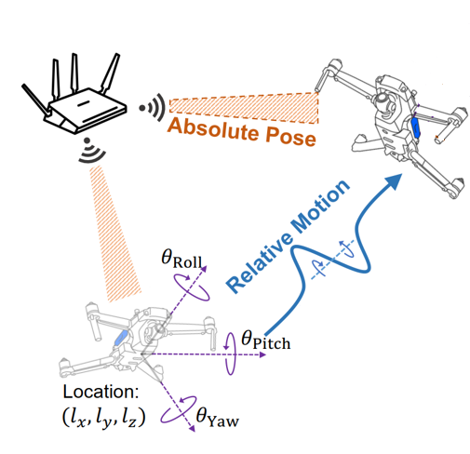
Wi-Drone System Overview
Exteroceptive Tracking：
The drone takes the AP as the anchor;
The drone infers its own pose by “observing” the AP’s pose during the flight;
Estimate the absolute pose in the AP reference, without cumulative drift;
Proprioceptive Tracking ：
The drone infers its relative pose by “perceiving” the signal phase change;
Estimate the relative pose change in a finer granularity.
Notes:
The problem is how to design such a system?
Our key observation is that the Wi-Fi signal can be utilized from two different perspectives.
[CLICK] On the one hand, the drone can directly take the access point (AP) as an anchor during its flight and estimates its absolute pose by "observing" the AP. We call it Exteroceptive Tracking.
[CLICK] On the other hand, the drone can also estimate its relative pose with respect to the last moment by perceiving the phase change of the received Wi-Fi signal. We call it Proprioceptive Tracking.
那么具体该如何设计这样一个系统呢。
我们的一个核心观察是，Wi-Fi信号可以从两个不同的角度加以利用。
[CLICK] 一方面，无人机在飞行的过程中，可以直接将AP作为锚点，并持续不断地通过观察AP的位姿，来确认自身相对于AP的绝对位置，这类方法不会引起任何累积误差；
[CLICK] 另一方面，在无人机飞行的过程中，它也可以感受接收到Wi-Fi信号的相位，并根据相位的变化来估计自身相对于上一时刻的位姿变换。这类方法的粒度更细，且并不会直接参考AP的位姿；
The geometric relationship between the drone and the AP is constructed explicitly.

Slide 10
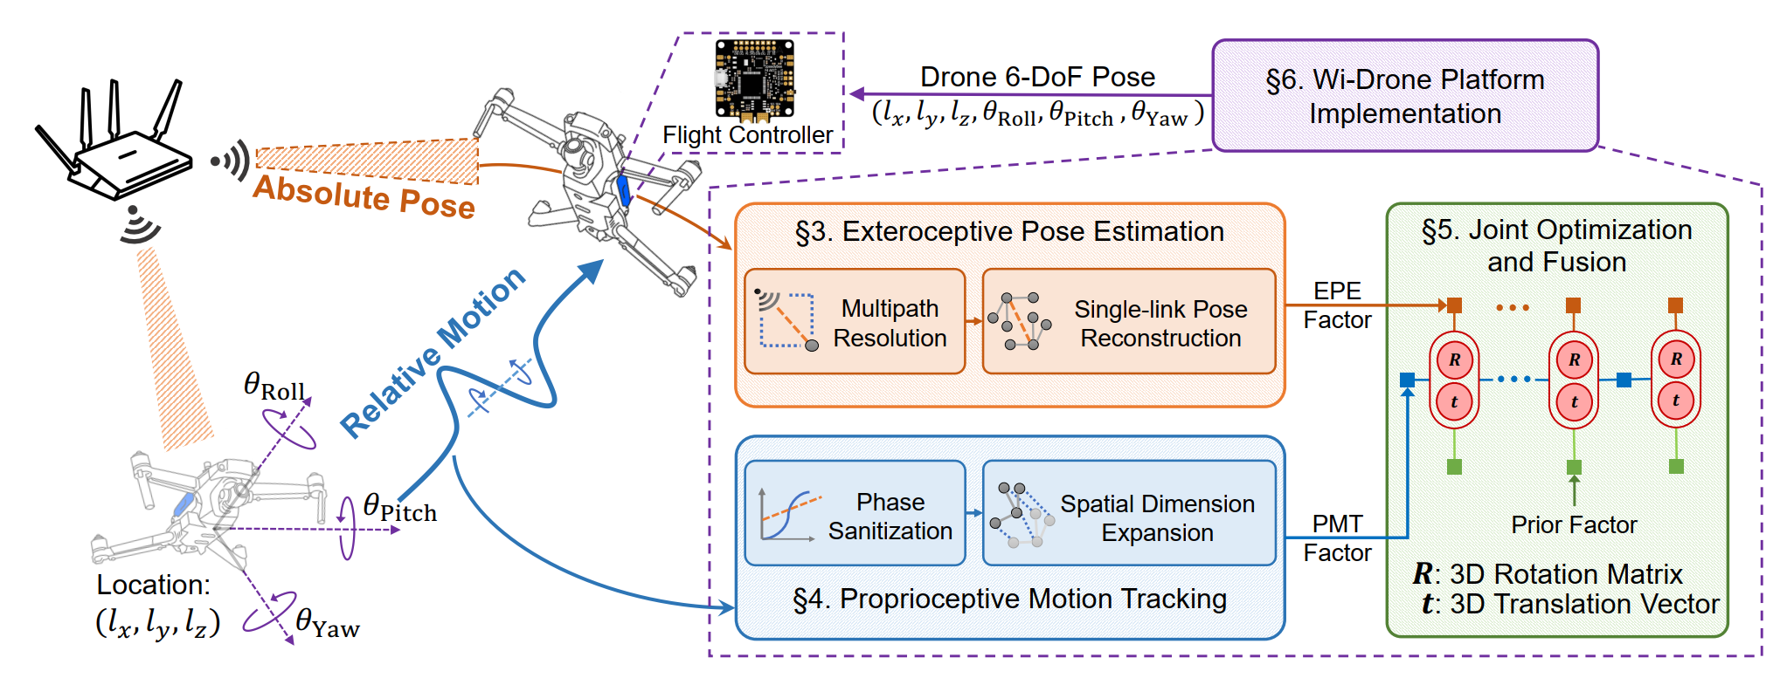
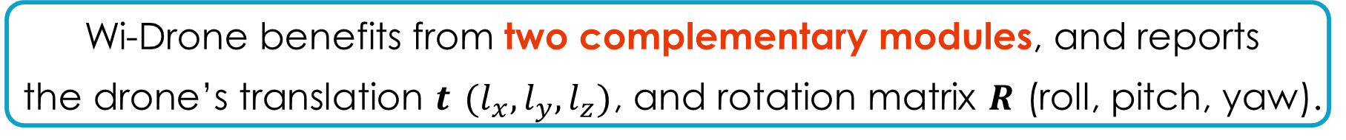
Wi-Drone System Overview
Wi-Drone benefits from two complementary modules, and reports the drone’s translation $t$ $(l_{x}, l_{y}, l_{z})$, and rotation matrix $R$ (roll, pitch, yaw).
Notes:
Therefore, we design the Wi-Drone framework as follows:
[CLICK] First, we designed an Exteroceptive Pose Estimation (EPE) module, which treats the signal as exteroceptive measurements. This module takes the AP as the anchor and thus is free of cumulative drift. The EPE module estimates the drone's absolute pose by observing the geometric channel parameters between the drone and the AP, and establishes the geometric relationship between the AP and the drone.
[CLICK] We also designed the Proprioceptive Motion Tracking (PMT) module. It leverages the signal as proprioceptive measurements, which means it infers the drone's relative motion change by perceiving the temporal difference of the received signal.
[CLICK] Finally, the designed Joint Optimization and Fusion (JOF) framework takes both the absolute pose and relative pose as input and reports an optimized 6-DoF pose in real-time, including the translation vector 𝒕 and the rotation matrix 𝑹.
因此，Wi-Drone的架构设计应该是这样的，
[CLICK] 从“外源观测”的角度出发，我们设计了EPE模块，该模块通过解析无人机和AP之间的直射信号，来构建无人机和AP之间的几何关系；
[CLICK] 而从“内源感受”的角度出发，我们设计了PMT模块，该模块通过分析信号相位的变化，来推断相对运动；
[CLICK] 两模块的结果在经过联合优化后，生成准确的6-DoF估计，包括无人机的平移向量，以及旋转矩阵，上述信息被传输到无人机被用于飞行控制与任务执行。

Slide 11
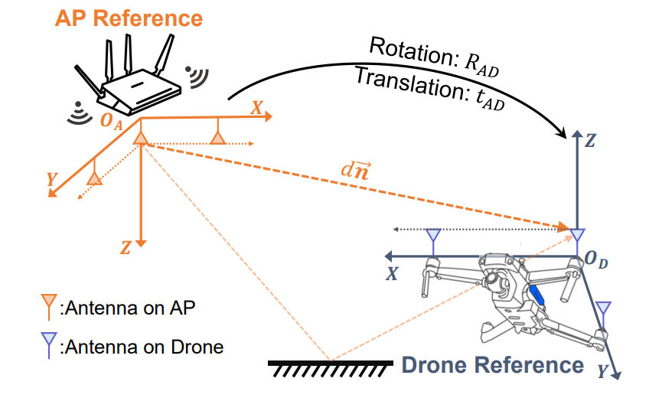


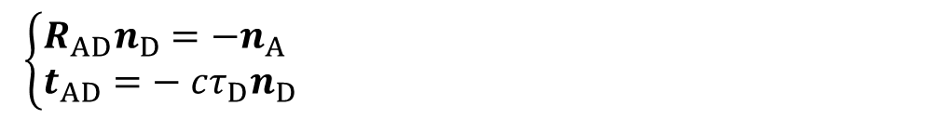
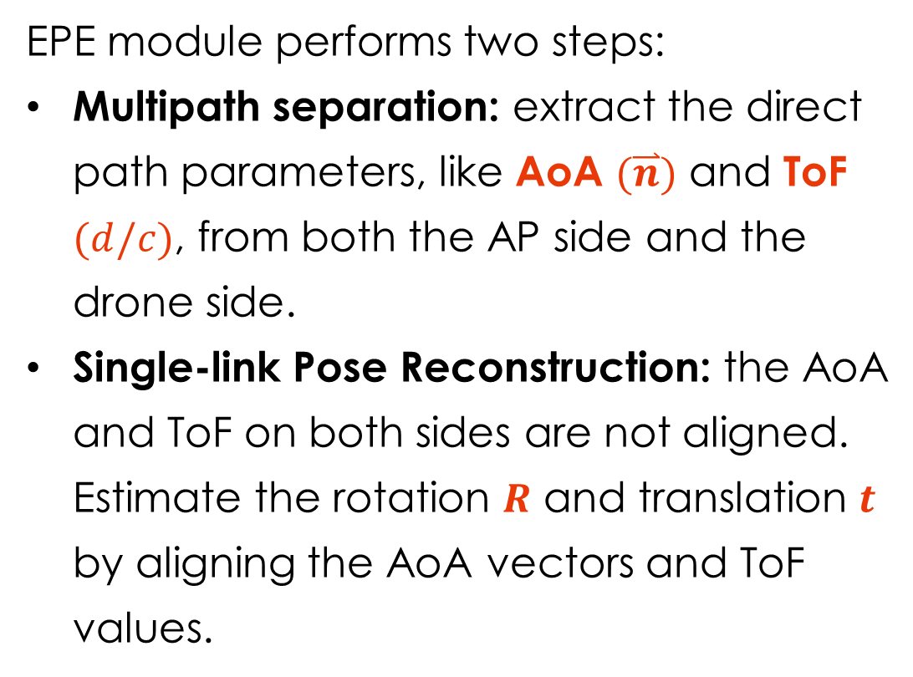
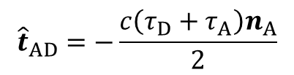

Exteroceptive Pose Estimation (EPE)
EPE module performs two steps:
Multipath separation: extract the direct path parameters, like AoA $(\overset{⃑}{n})$ and ToF $(d/c)$, from both the AP side and the drone side.
Single-link Pose Reconstruction: the AoA and ToF on both sides are not aligned. Estimate the rotation $R$ and translation $t$ by aligning the AoA vectors and ToF values.
Get the rotation by aligning the AoA vector.
$\left\{\begin{aligned}&R_{AD}n_{D}=−n_{A} \\ &t_{AD}=− cτ_{D}n_{D}\end{aligned}\right.$
Get the translation based on the ToF value.
$${\hat{R}}_{AD}=\arg{\min_{R_{AD}}} {∥R_{AD}n_{D}+n_{A}∥}_{2}^{2}$$
Form into an
optimization problem.
$${\hat{t}}_{AD}=−\frac{c\left(τ_{D}+τ_{A}\right)n_{A}}{2}$$
Notes:
Let me first introduce the Exteroceptive Pose Estimation part.
The EPE module performs basically two steps:
First, the EPE module separates multiple path signals, extracting the direct path's channel parameter, including the Angle of Arrival (AoA) vector 𝒏, and the Time of Flight (ToF). With this information, we know both the channel's direction and distance.
On this basis, the EPE module tries to reconstruct the drone's rotation and location. You may notice that the directional vector 𝒏 is represented differently as $n_{D}$ and $n_{A}$ under the drone's and the AP's perspectives. That's because the drone and the AP are in different reference systems.
[CLICK] And a rotation transformation can be applied to "align" two reference systems. This rotation matrix is exactly the drone's 3D rotation state.
[CLICK] The translation vector can also be inferred from the time-of-flight measurement.
[CLICK] The above equations can be translated to an least-square optimization problem, which can be easily solved based on matrix decomposition.
Therefore, we can get both the drone's rotation and translation estimation in the drone reference.
展开来讲，EPE模块主要包括两个步骤：多径分离和单链路位姿重建。
首先，多径分离负责从叠加的多径信号中估计出直射路径的几何参数，包括AoA方向向量，以及ToF测量。无人机端和AP端的AoA和ToF都需要被提取。
在此基础上，我们发现无人机端和AP端提取的AoA的表示并没有对齐，这是因为他们处在不同坐标系下导致的。
通过估计无人机和AP之间的相对旋转变换，找到一个能够将两端测量的AoA向量“对齐”的旋转矩阵，即可完成旋转估计。
在获取旋转矩阵之后，基于ToF测量得到距离，我们即可确定二者之间的相对平移。
整个过程都可以被建模为一个最小二乘的优化问题。

Slide 12
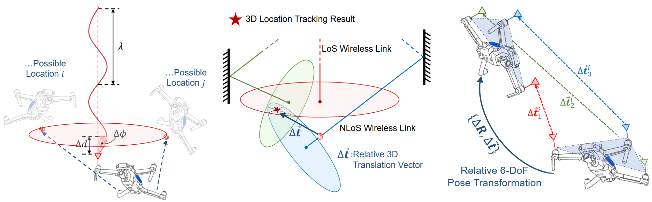
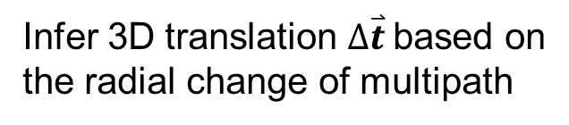
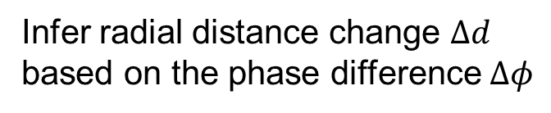
Proprioceptive Motion Tracking (PMT)
PMT leverages the 1-D phase difference to track 6-D relative pose.
Infer radial distance change $Δd$
based on the phase difference $Δφ$
Infer 3D translation $Δ\overset{⃑}{t}$based on
the radial change of multipath
Infer the drone’s overall pose based on multiple antennas
Notes:
The PMT module leverages the 1-D signal phase to track the 6-D relative motion.
This process can be summarized as the following 3 steps:
1. First, from the 1-D phase change, we can infer the radial distance change. As shown in the left figure, based on a phase change Δ𝜙, we know that the drone experiences a relative distance change 𝛥𝑑. Therefore, the drone must be somewhere on the red plane. But since we only know the distance change in one dimension, we cannot determine whether the drone is at location i or location j.
2. Further, we can extract such a phase change on multiple paths. For example, as shown in the figure, by leveraging three paths, now, we can determine the 3D location by taking the intersection point of the three planes.
3. As the drone rotates, different antennas experience different location changes. Therefore, we can perform the above steps two for each antenna to determine each antenna's 3D location change. And since multiple antennas are rigidly attached to the drone, we can infer the drone's overall rotation based on each antenna's motion.
So far, we have reconstructed the 6-DoF relative pose change from the signal phase on different paths from different antennas.
关于PMT模块的基本思想，则是利用相位变化推断细粒度的相位位姿转换。
这个过程可以主要分为从左至右的三步。
首先，通过相位差，我们可以推断出无人机在短时间内的径向移动距离，这个信息只是1维的，因此具有一定的模糊性。比如图中，我们能够知道无人机应当位于这个红色的平面上的某个位置，但是我们并不确定是位置i还是位置j；
为了解决这个模糊性，我们借助多径来获取更高维度的信息。具体来讲，多径信号提供了多个不同方向上的相位变化，每条路径对应一个平面。多个平面交于的一点，即可确定无人机上某一根天线的相对位移；
考虑到无人机整体存在旋转，因此无人机上的不同天线会经历不同的微小位移。因此，借助多天线和刚体运动学，我们可以推断出无人机作为一个整体的旋转和位移。
这样，我们实现了从1D的相位信息中重建无人机6D的相对运动。

Slide 13
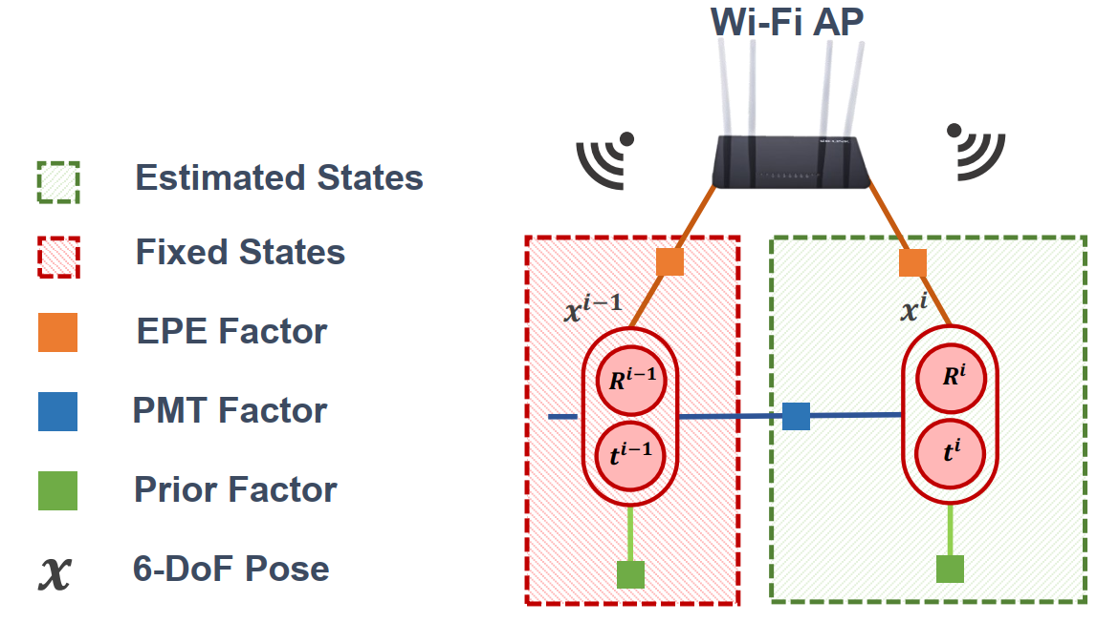

Joint Optimization and Fusion (JOF)
JOF module is based on a factor graph:
EPE factor indicates the absolute pose in the AP reference.
PMT factor indicates the pose change relative to the previous moment.
Prior factor indicates estimated pose based on constant velocity assumption.
Three error terms are jointly minimized.
A fine-grained 6-DoF trajectory without cumulative drift is reconstructed.
$$\{\hat{R_{i}}, \hat{t_{i}}\}=\underset{{\{R}_{i}, t_{i}\}}{arg min}\left(E_{i}^{prior}+E_{i}^{EPE}+E_{i}^{PMT}\right)$$
Prior Error
EPE Error
PMT Error
Notes:
Finally, we construct a factor graph to optimize the output of the EPE and the PMT module.
Specifically, we factorize the EPE and PMT as two different types of nodes, each representing their unique tracking models.
We also introduce a constant velocity assumption into the optimization framework.
Three error terms are jointly minimized, and a fine-grained 6-DoF trajectory without any cumulative drift is reconstructed.
Due to the time constraints, we only illustrate the basic concepts here.
For more mathematic details, please refer to our paper.
最终，我们将EPE模块的绝对位姿推断模型和PMT模块的相对位姿推断模型构造成EPE和PMT因子，并考虑无人机的匀速运动假设，构造一张因子图。
通过对因子图进行优化，找到一个能够将三类误差整体最小化的位姿，即可完成融合优化过程。
综合EPE和PMT模块优化后的位姿，兼具了两个模块的优点：细粒度，且无累积漂移。

Slide 14
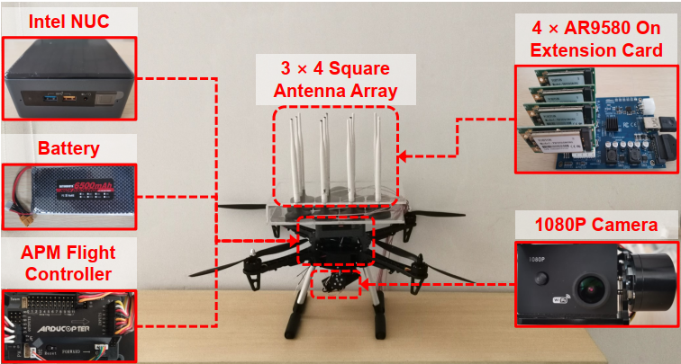
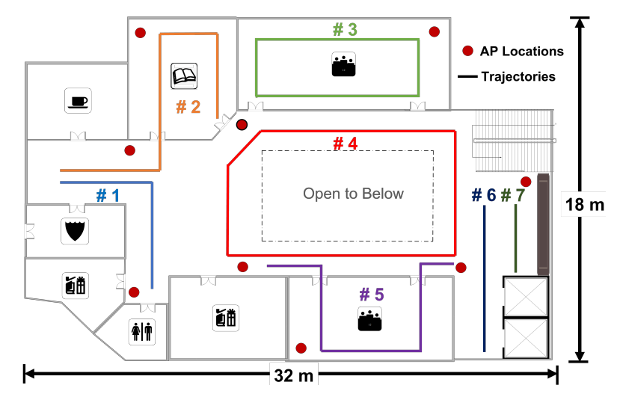
Experiment Setup
System implementation：
3 × 4 antenna array.
4 × AR9580 commercial NIC.
Industrial drone with APM flight controller.
Field Study:
Experiments are conducted in an office building.
Typical Wi-Fi AP deployment.
3D trajectories with path length from 5 to 30 m.
Normal / Low-light-level / Texture-less scenarios.
Ground Truth
OptiTrack with sub-millimeter-level accuracy.
System Implementation
Trajectory setup
Notes:
As shown on the right, we implement the Wi-Drone on an industrial drone, with four commercial NICs; and a total number of 12 antennas forming into a three-times-four antenna array.
Our experiments are conducted in an office building with several typical indoor scenarios. And various types of 3D trajectories are designed with diverse rotation angles, pose transfer speeds, and path lengths from 5 m to 30 m. The optiTrack cameras report the trajectory ground truth in millimeter-level accuracy.
我们实际在一个工业无人机上实现了Wi-Drone，使用了4张AR 9580网卡共12根天线进行了测试。
我们的实验场景选定在一个办公楼内。
我们设计了许多条不同速度、旋转角度的轨迹，长度从5米到30米。实验过程中的Ground truth是由OptiTrack获取的，精度在亚毫米级别。

Slide 15
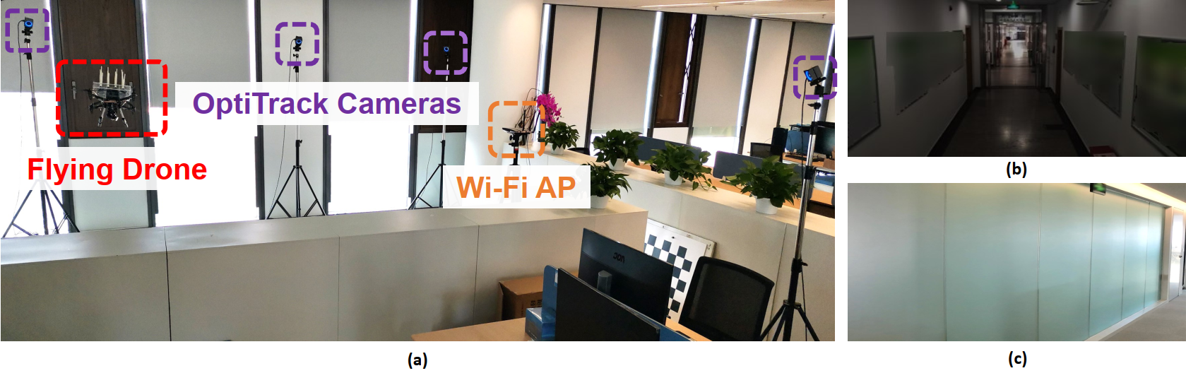
Experiment Setup
An experimental scenario with satisfactory conditions.
A low-light-level scenario from the drone’s perspective.
A texture-less scenario from the drone’s perspective.
Notes:
These figures show the experimental setup and scenarios.
Figure (a) shows a scenario with satisfactory light and texture conditions.
In addition, we also conducted several experiments in low-light-level scenes and texture-less scenes, as shown in figure (b) and (c).
这张图展示了真实的实验场景。
图（a）中展示了我们的设备部署和一个常见的实验场景。
图（b）和（c）分别展示了低照度和弱纹理的实验场景。

Slide 16
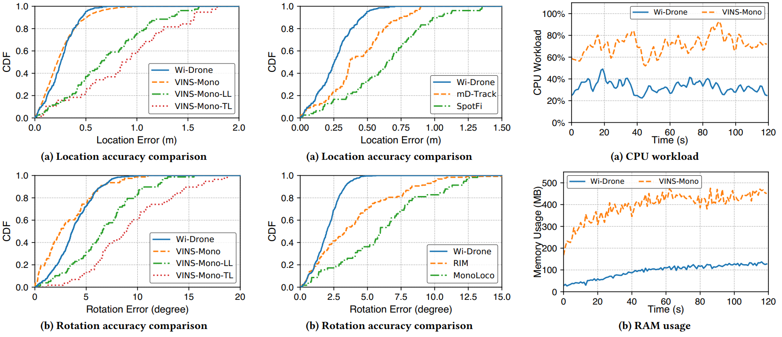
Experiment – Overall Performance
Wi-Drone achieves comparable performance with vision-IMU-based methods, with an average location tracking accuracy of 26.1 cm, and an average rotation accuracy of 3.8°.
2D Rotation
Accuracy comparison with VINS-Mono
Accuracy comparison with
Wi-Fi-based solution
Resource consumption
Wi-Drone’s rotation accuracy exceeds VINS by > 40% in low-light and texture-less scene.
Wi-Drone’s location accuracy exceeds VINS by > 60% in low-light and texture-less scene.
Wi-Drone’s 2D rotation accuracy exceeds other Wi-Fi-based solutions by > 50%
Wi-Drone’s CPU workload outperforms VINS by 40%, with more than 3× memory saving
Wi-Drone’s location accuracy exceeds other Wi-Fi-based solutions by > 40%
Notes:
We compare Wi-Drone with vision-IMU-based solution VINS-Mono and several Wi-Fi-based tracking solutions.
[CLICK] The overall performance shows that Wi-Drone achieves comparable performance with vision-IMU-based methods, with an average location tracking accuracy of 26.1 cm, and an average rotation accuracy of 3.8°.
[CLICK] Besides, compared with VINS-Mono, Wi-Drone's location accuracy exceeds VINS by > 60% in low-light and texture-less scenes.
[CLICK] And the rotation accuracy exceeds VINS by > 40% in low-light and texture-less scenes.
[CLICK] Compared with Wi-Fi-based solutions, Wi-Drone's location accuracy outperforms by > 40%.
[CLICK] And its 2D rotation tracking accuracy exceeds others by > 50%. We test the 2D rotation instead of 3D because existing Wi-Fi-based solutions can only track the 2D rotation.
[CLICK] We also evaluate the computation resource consumption of Wi-Drone. Compared with VINS, its CPU workload reduces by over 40%, and achieves more than 3x memory saving.

Slide 17
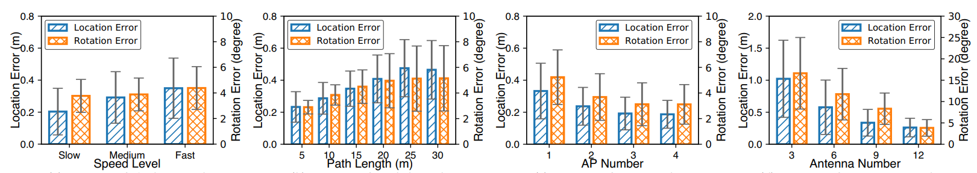
Experiment – Robustness Analysis
Wi-Drone can still achieve 35 cm / 3.5° accuracy with a flight speed > 3 m/s
Wi-Drone’s performance converges to 47 cm / 5.1° with path length > 25 m
Impact of flight speed
Impact of path length
Wi-Drone’s performance increases with the number of AP. The performance is 32.2 cm / 5.2° with only one AP.
Wi-Drone’s performance decreases from 26 cm / 3.8° to 102 cm / 8.4°, as the antenna change from 12 to 3.
Impact of AP number
Impact of antenna number
Notes:
We also analyze the system's robustness.
[CLICK] As shown, Wi-Drone works well under various flight speeds, and still achieves delightful performance under high speed.
[CLICK] And Wi-Drone is free of cumulative drift. As shown in the top right figure, Wi-Drone's performance converges to 47 cm and 5.1°, with a path length over 25 m.
[CLICK] In addition, the bottom left figure shows that Wi-Drone can work with any number of AP. Even with only one AP, Wi-Drone achieves a satisfactory result of 32.2 cm and 5.2° rotation accuracy.
[CLICK] The bottom right figure shows that Wi-Drone's performance highly depends on the number of antennas, and the performance decreases from 26 cm / 3.8° to 102 cm / 8.4°, as the antenna number changes from 12 to 3.

Slide 18
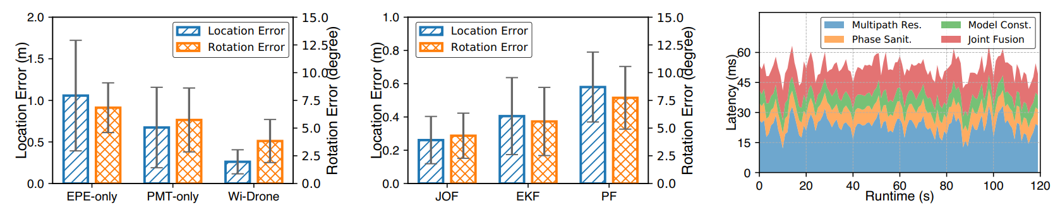
Experiment – Micro Benchmarks
Effectiveness of each module
Effectiveness of fusion algorithm
Latency analysis
Wi-Drone outperforms EPE-only and PMT-only by > 60% and 30% in term of location and rotation accuracy respectively.
Wi-Drone’s JOF module outperforms EKF and PF by > 30% and 20% in terms of location and rotation accuracy respectively.
Wi-Drone achieves an end-to-end latency of about 52.34 ms, in which 23 ms is induced by the multipath resolution algorithm.
Notes:
The micro-benchmark shows the effectiveness of each module in our system.
[CLICK] As shown, Wi-Drone outperforms EPE-only and PMT-only by > 60% and 30% in terms of location and rotation accuracy, respectively.
[CLICK] Besides, our graph-based JOF module also outperforms Extended Kalman Filter (EFK) and Particle Filter (PF) by over 30% and 20%.
[CLICK] We also analyze the system latency. As in the right figure, Wi-Drone achieves an end-to-end latency of about 52.34 ms.

Slide 19
Conclusion
We propose Wi-Drone:
The first Wi-Fi-based 6-DoF device tracking system.
Wi-Drone can be used for drone tracking and other 6-DoF-pose-driven tasks.
Wi-Drone works with any number of AP.
Wi-Drone can be directly migrated to a variety of Wi-Fi-ready devices.
We design two component and provide a fresh perspective:
Design a Exteroceptive Pose Estimation (EPE) module to estimate the absolute 6-DoF pose.
Design a Proprioceptive Motion Tracking (PMT) module to continuously track the relative 6-DoF pose change.
Propose a fresh perspective of fusing two complementary features from the same type of sensor data.
Implementation and Evaluation of Wi-Drone.
Notes:
Now, let's summarize our key contributions.
1. First, we propose Wi-Drone, the first Wi-Fi-based 6-DoF device tracking system.
Wi-Drone can be used for indoor drone tracking, as well as other 6-DoF-pose-driven tasks.
Wi-Drone works with any number of AP, and achieves delightful performance even with only one AP available.
As a lightweight solution, Wi-Drone can be directly migrated to various Wi-Fi-ready devices.
2. Second, we designed two components for 6-DoF tracking with different methodologies. We designed an Exteroceptive Pose Estimation (EPE) module to estimate the absolute 6-DoF pose, and a Proprioceptive Motion Tracking (PMT) module to continuously track the relative 6-DoF pose change. We also propose a fresh perspective of fusing two complementary features from the same type of sensor data.
3. Finally, we implement the Wi-Drone prototype, and extensively evaluate its performance with both vision-based and other Wi-Fi-based solutions.

Slide 20
Thanks!
Q&A
Kun Qian
University of California San Diego
qiank10@gmail.com
Notes:
(Ending…)
So much for my presentation, thank you.

