Slide 1


Motion Inspires Notion: Self-supervised Visual-LiDAR Fusion for Environment Depth Estimation
Danyang Li¹, Jingao Xu¹, Zheng Yang¹ , Qian Zhang¹, Qiang Ma¹,
Li Zhang², Pengpeng Chen³
¹ School of Software and BNRist, Tsinghua University
² HeFei University of Technology ³ China University of Mining and Technology
ACM MobiSys 2022
1

Slide 2
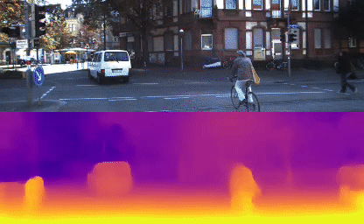
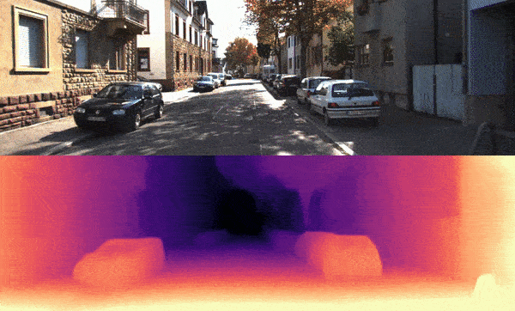
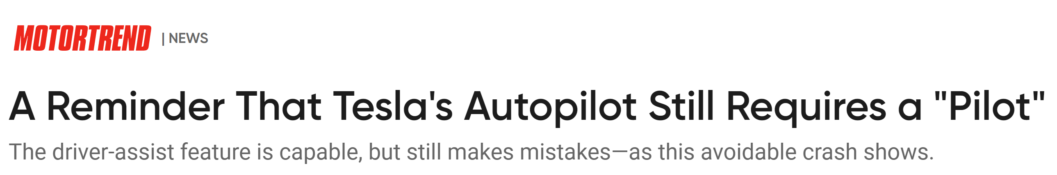
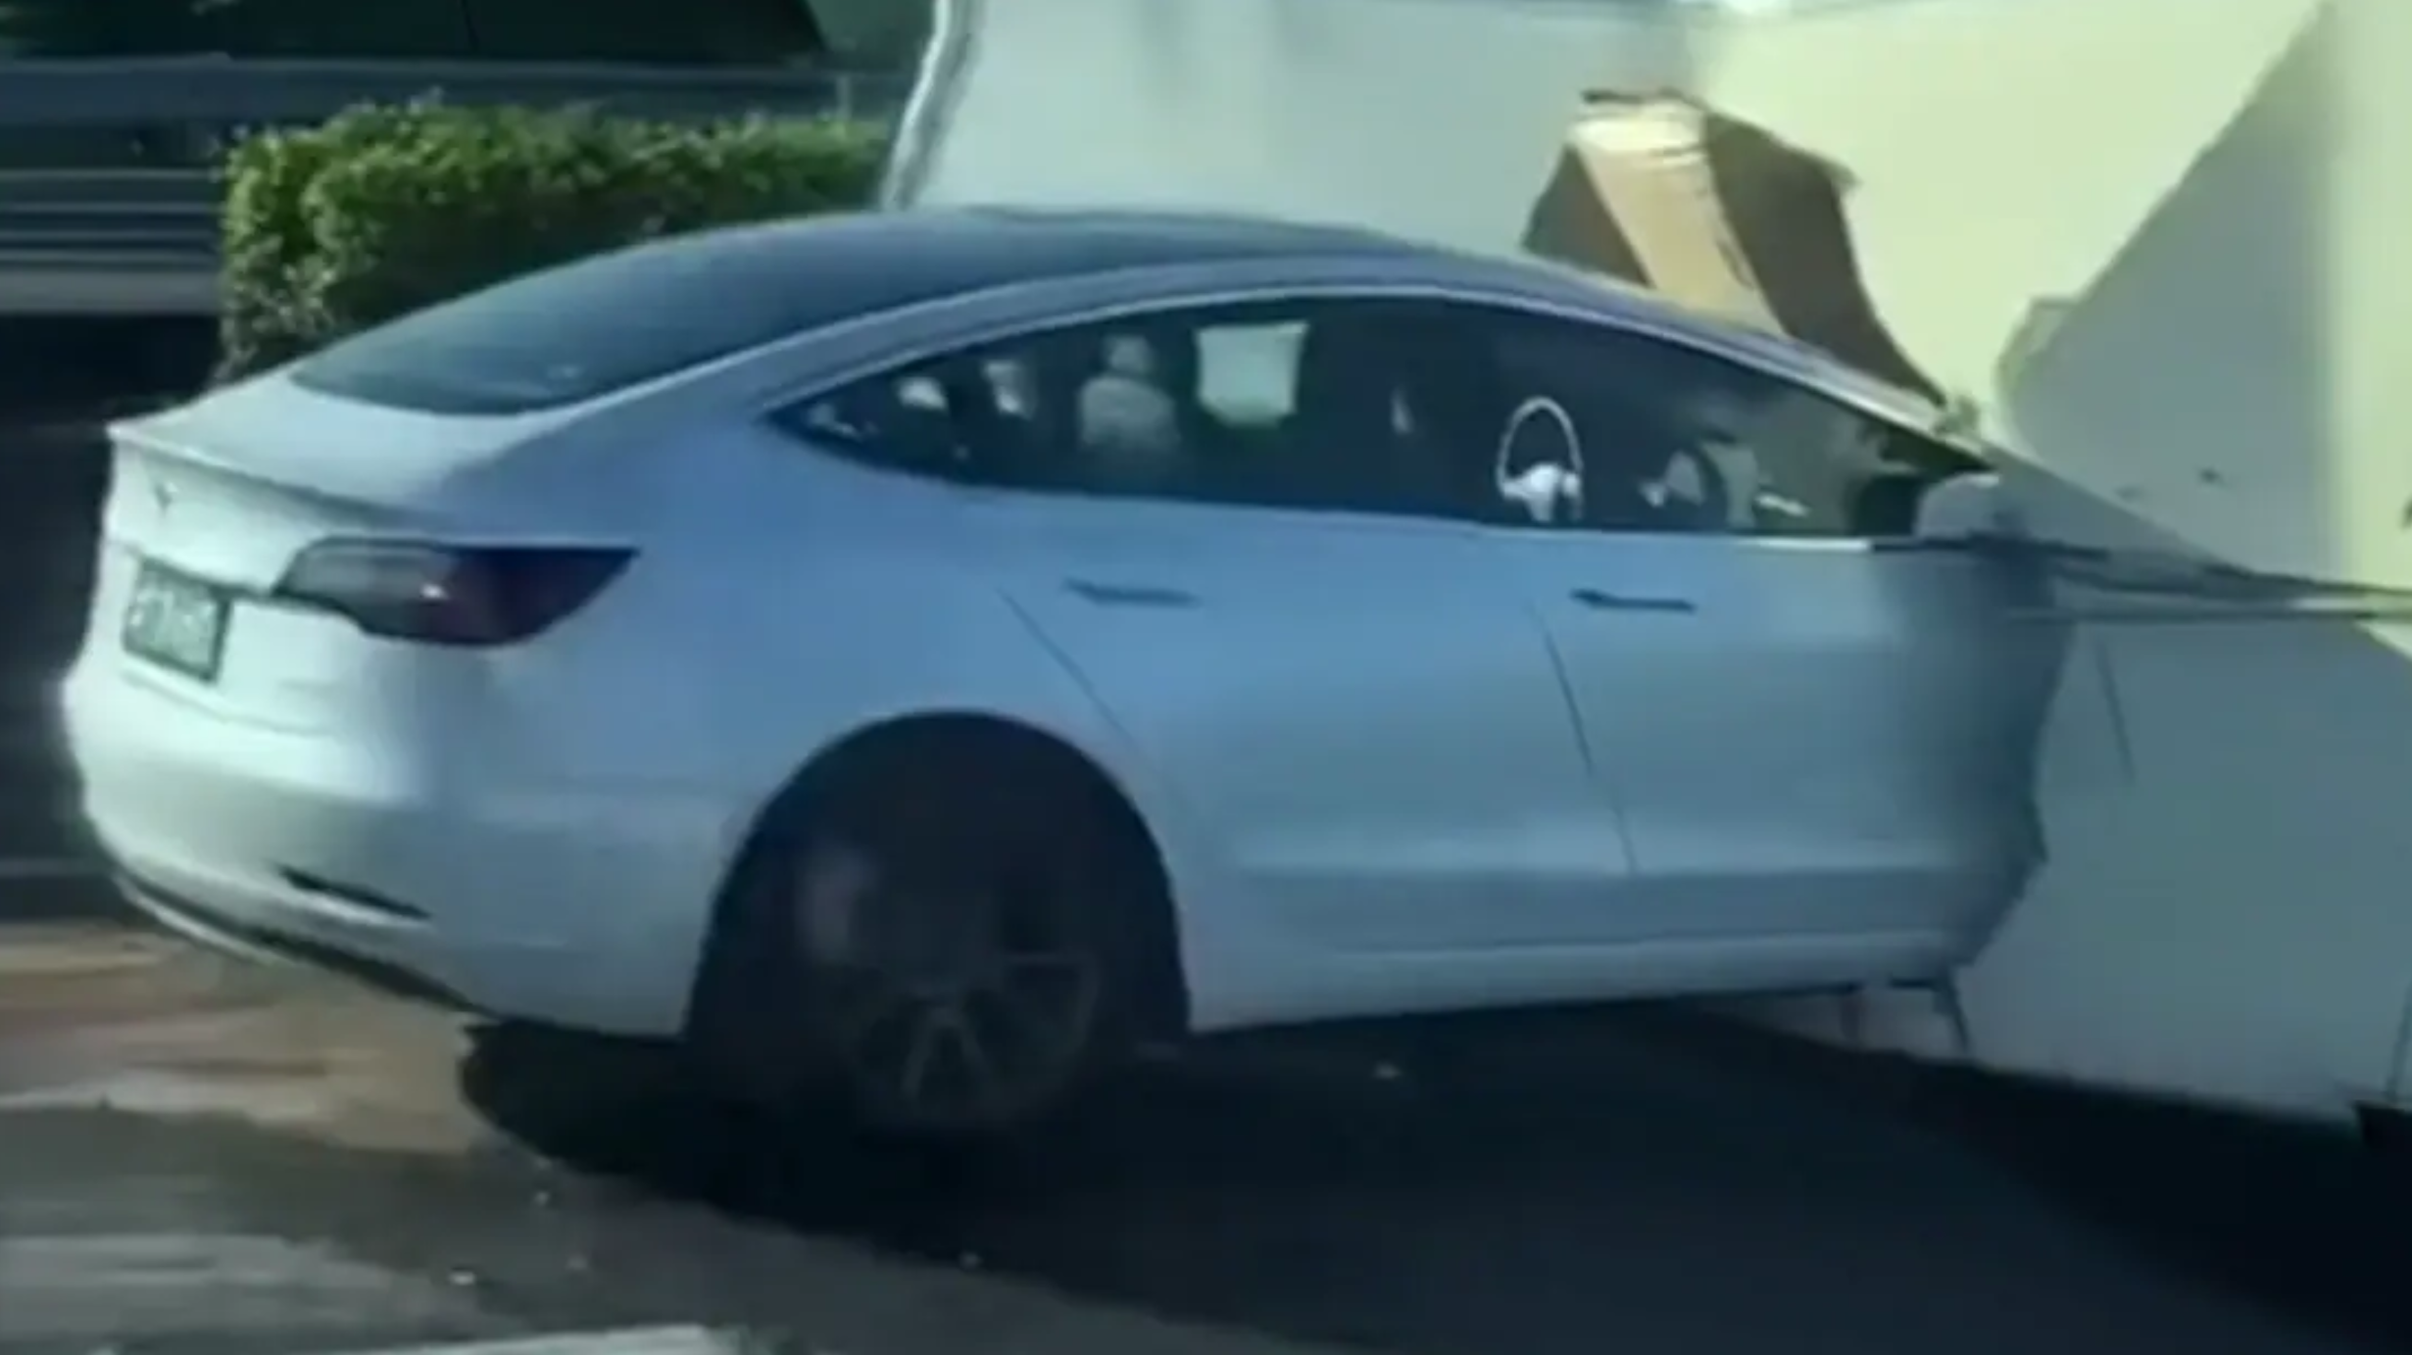
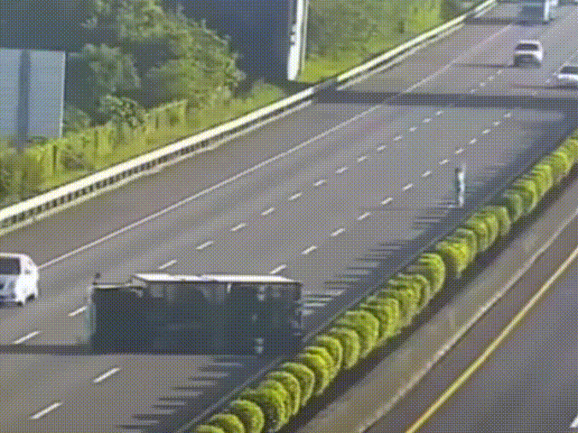
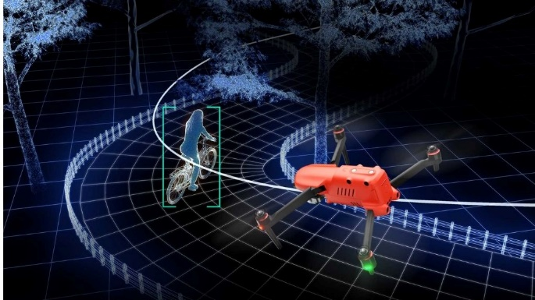
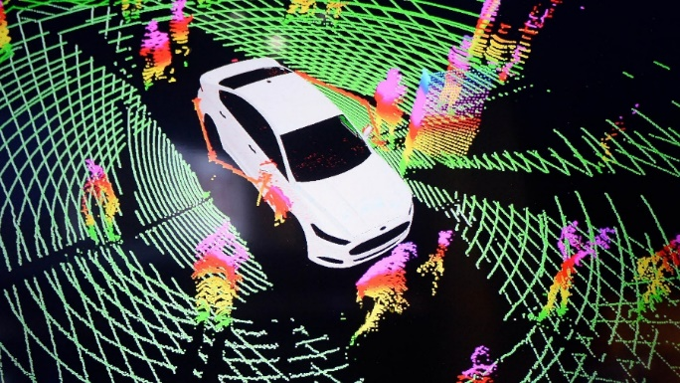
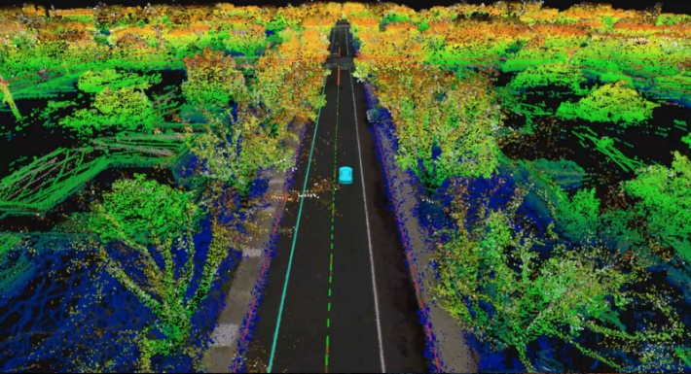

Environment Depth Estimation
RGB Image
***Wrongly estimating the depth of objects causes a majority of autonomous driving accidents!
Depth Map
Real-time Navigation
Obstacle Avoidance
Dense Mapping
2
Notes:
Environment Depth estimation aims to obtain geometric properties of surrounding space from 2D images and associated sensor inputs.
Typically, it generates a depth map for each input image, which is an additional image channel that contains distance information of objects from associated image pixels.
The benefit of depth estimation is to enhance the environmental perception capability of intelligent machines, which lies in the heart of numerous applications, [Click] such as Real-time Navigation, Obstacle Avoidance, and Dense Mapping.
[Click] According to recent reports, wrongly estimating the depth of humans and obstacles causes a majority of auto-driving accidents in past two years.

Slide 3
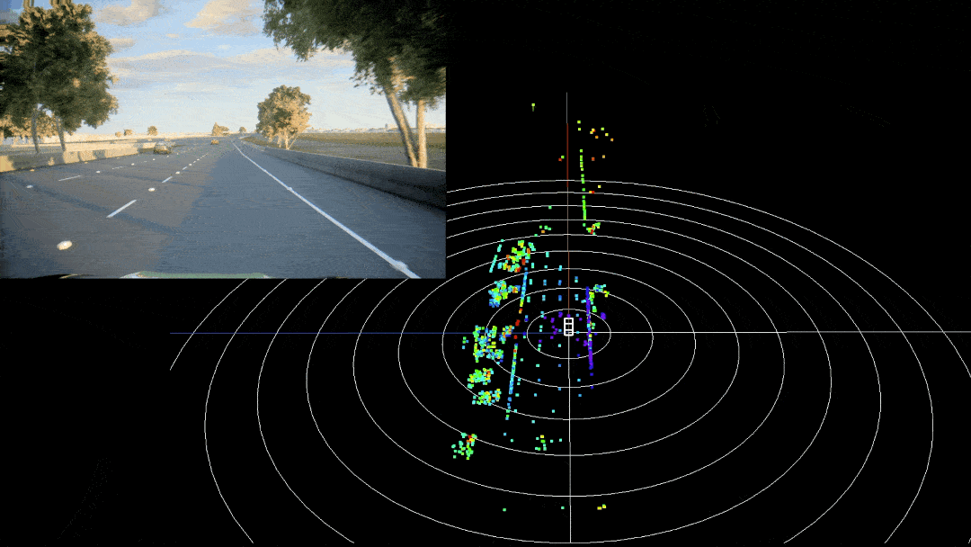
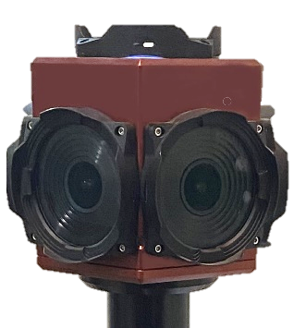
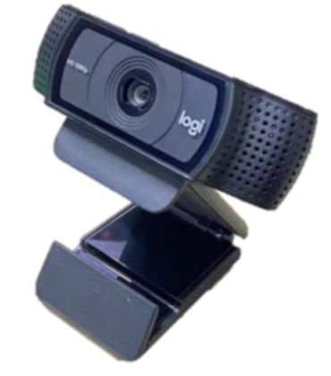

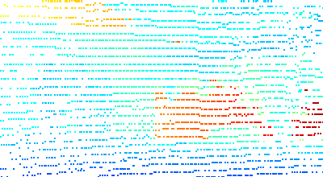
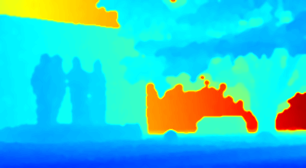
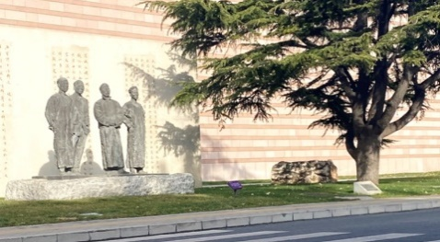

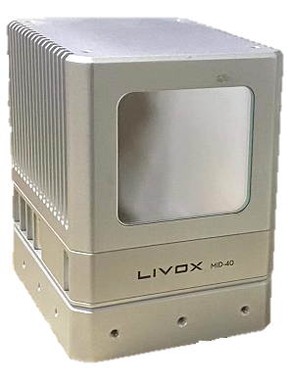
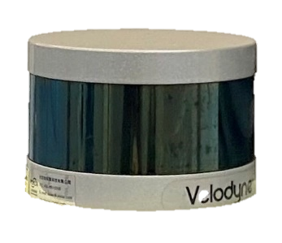
Visual-LiDAR Fusion
Sparse2Dense (ICRA’18)
DeepLiDAR (CVPR’19)
DenseLiDAR (RAL’21)
RGB Camera
RGB Image
Dense LiDAR Points
Generator
(DNN)
Depth Map
Self-S2D (ICAR’19)
Self-VLO (WACV’21)
……..
RGB Image
LiDAR
LiDAR Point Cloud
3
Notes:
Current depth estimation practice on self-driving typically combines camera and LiDAR to complement each other's strengths.
Compared to visual stand-alone approaches, LiDAR could provide the accurate 3D location of reflection points, and compensate the shortcomings of visual depth mis-estimation due to the lack of scale information.
[Click] To fully exploit the potential of both sensors, the SOTA visual-LiDAR fusion approaches design Deep Neural Networks as Depth Map Generator, take 2D visual images and associated Dense LiDAR points as input, to generate the depth map of surroundings.

Slide 4
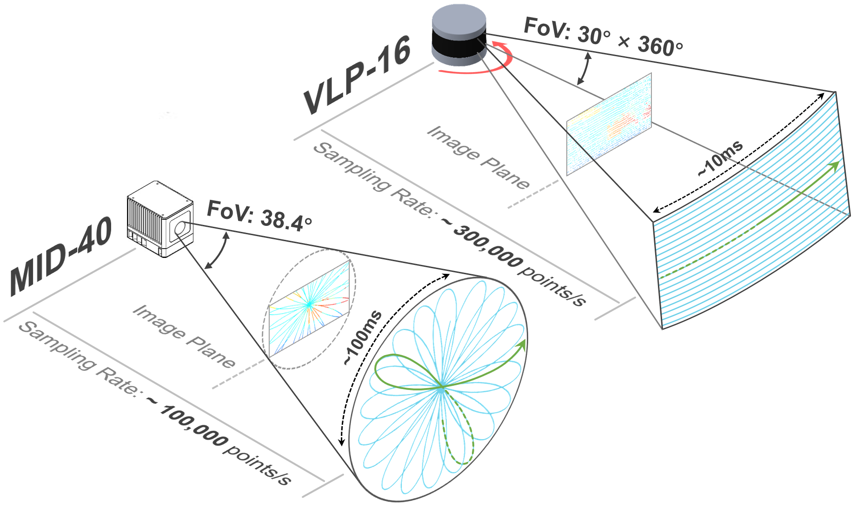
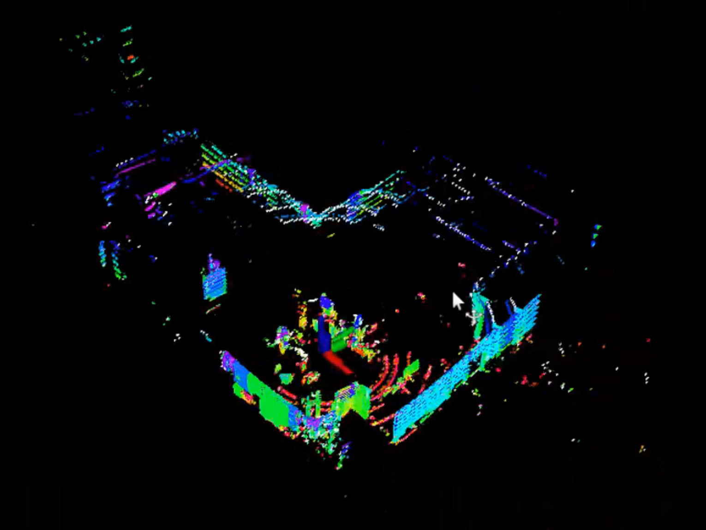
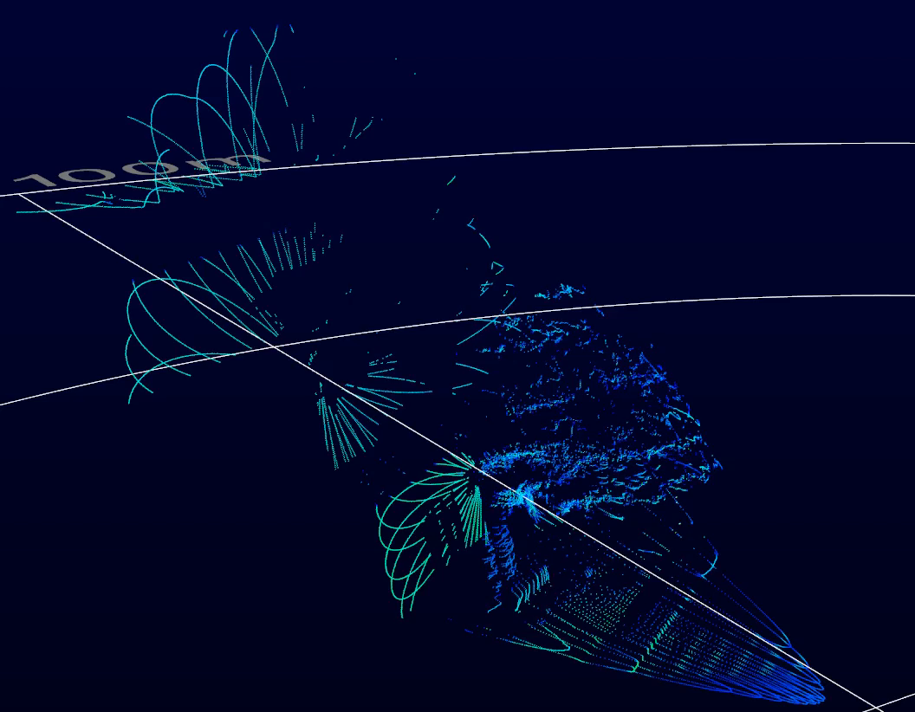
Different types of LiDAR
Mechanical spinning LiDAR:
--Velodyne VLP-16 $4,000
Solid-state LiDAR:
--Livox Mid-40 $500
4
Notes:
Although current practice achieves great depth mapping performance, they primarily rely on sophisticated yet expensive LiDAR, such as Mechanical spinning LiDAR: Velodyne VLP-16, which cost around $4,000.
In contrast, due to the consideration of device cost, most vehicles are merely equipped with lower-cost yet sparsely sampled LiDAR, such as Solid-state LiDAR: Livox Mid-40, which costs only $500.
As illustrated in this figure, Mid-40 generates merely one-third as many 3D points as VLP-16 within a scan cycle and suffers from a narrower Field-of-View coverage.

Slide 5
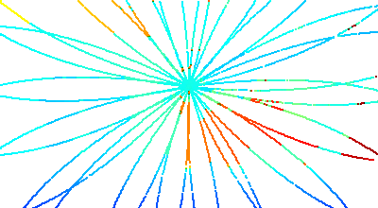
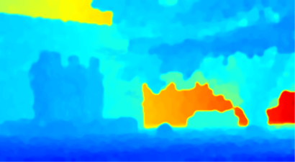
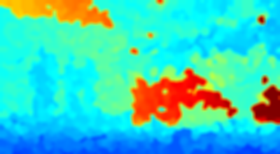
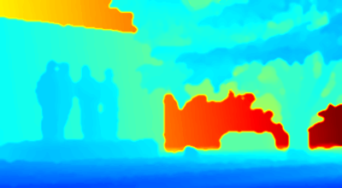

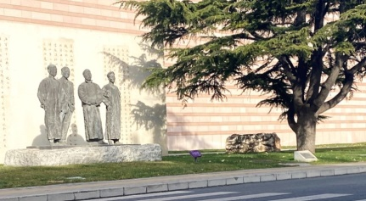
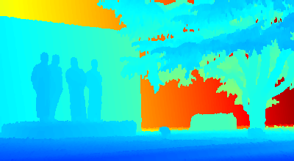
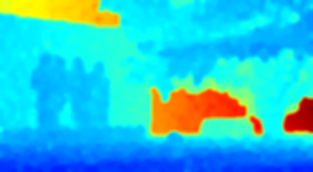
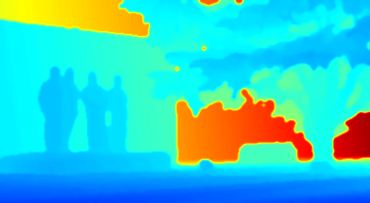

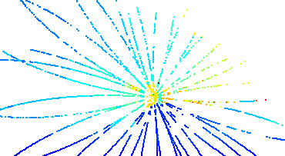
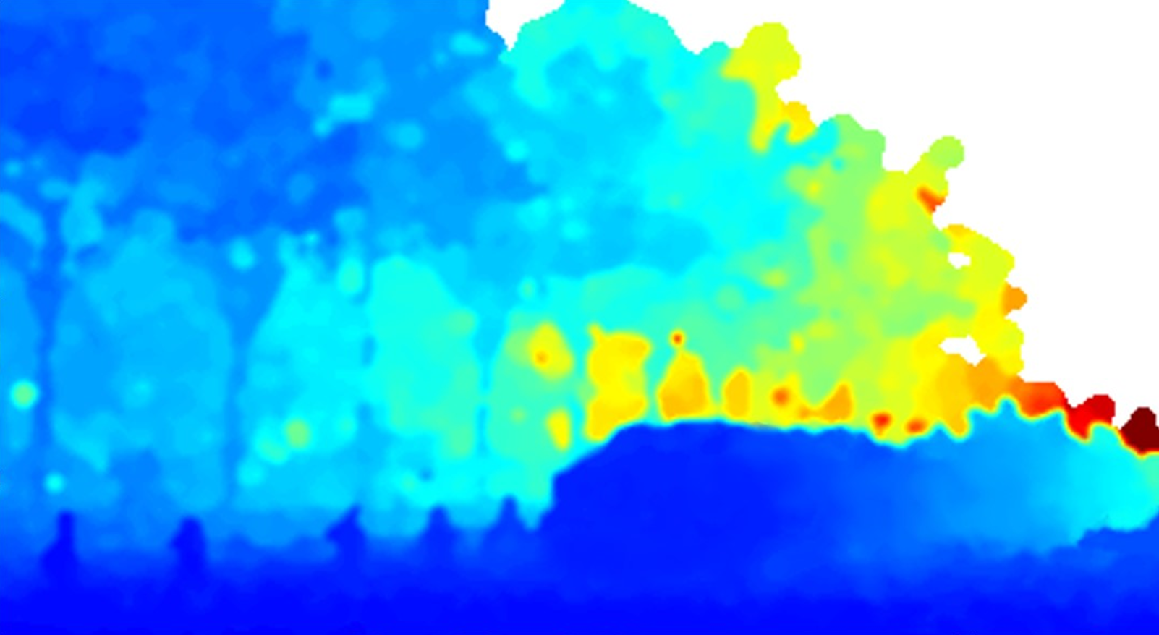
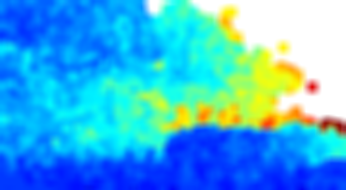
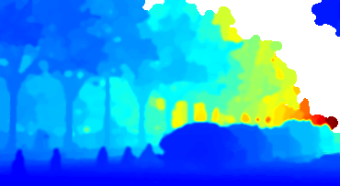
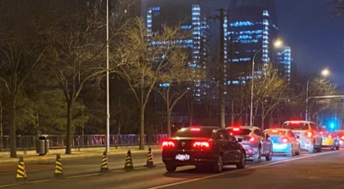
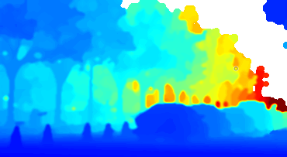
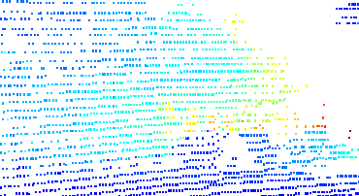
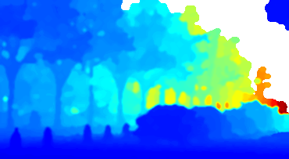
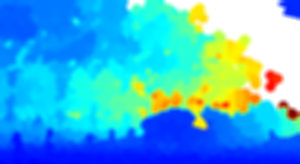
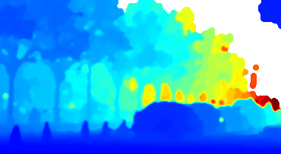
Related Work
Mid-40
0.29m
0.48m
0.16m
Static Scene
VLP-16
0.17m
0.34m
0.14m
Mid-40
0.36m
0.68m
0.19m
Dynamic Scene
VLP-16
0.21m
0.46m
0.17m
LiDAR Point Cloud
Supervised Learning
Self-supervised Learning
LeoVR
(Our Work)
Ground Truth
5
Notes:
With more sparse and irregular point clouds, the depth estimation performance of existing works degrades.
[Click] As shown in the figure, the estimation accuracy of the supervised learning based method was reduced by almost 50% when equipped with the sparsely sampled Mid-40, and make it difficult to segment sculptures and vehicles in the generated depth maps.
Besides, these deep-learning based solutions typically need pixel-level depth ground truth annotations to train the generator in advance, resulting in high labor cost and system overhead.
[Click] Although some recent works have proposed self-supervised learning methods to reduce the burden, the estimation performance of the model also degrades in real environments. As shown, compared to the depth maps generated in the static scene, the estimation error expands dramatically when the model cold start in a complex environment.
[Click] To solve the above two challenges, we propose LeoVR, a self-supervised solution that enables accurate depth estimation by fusing camera and LiDAR.

Slide 6







Motion Inspires Notion: LeoVR
Option2：Projection with motion
$$t_{i}$$
…
Depth Map
Generator
Depth Map $D_{i}$
Option1: Generate depth map directly
$$t_{j}$$
Depth Map $D_{j}$
Vehicle’s motion information could provide additional spatio-temporal constraints among successive depth maps.
6
Notes:
Now, let’s briefly illustrate the key insight of LeoVR. At moment t_i, the model generates a depth map D_i based on the input of visual and LiDAR.
[Click] At the next moment t_j, the model can generate a depth map D_j based on the current input.
[Click] And D_j could also be partially inferred by that of the previous frame and the inter-frame motion of the vehicle.
[Click] These spatio-temporal constraints could be served as prior information to optimize depth maps, and on the other hand, provide guidance for extracting reliable pixel-level supervision signals to train the model.

Slide 7
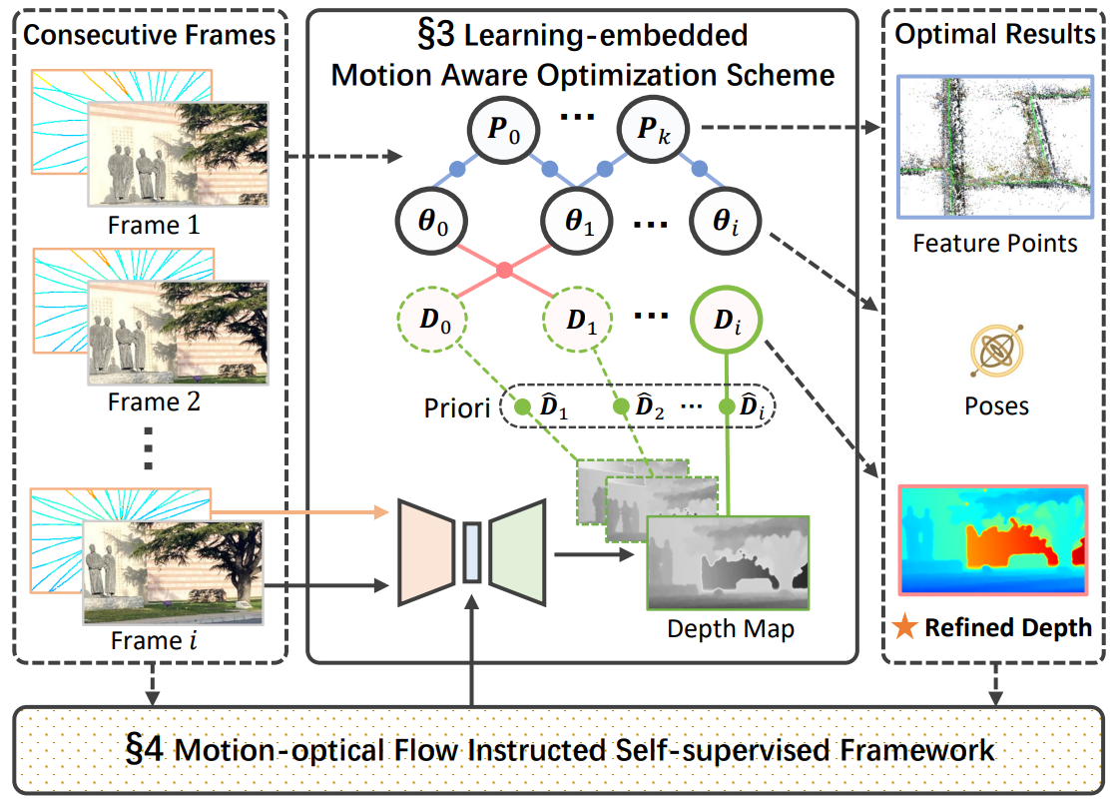
System Overview
LeoVR：Motion-aware Learning-embedded optimization scheme for Visual-Radar fusion
7
Notes:
Compared to current practice, Our design of LeoVR excels in three aspects.
[Click] First, LeoVR takes consecutive time-synchronized images and LiDAR measurements as inputs, exploits vehicle motion information and guides the optimization.
[Click] Second, we treat the depth map generated by the model as an intermediate depth priori for further factor graph based optimization.
[Click] Finally, in addition to optimizing the depth map, we also reserve both vehicle pose and spatial feature points to instruct self-supervised training.

Slide 8
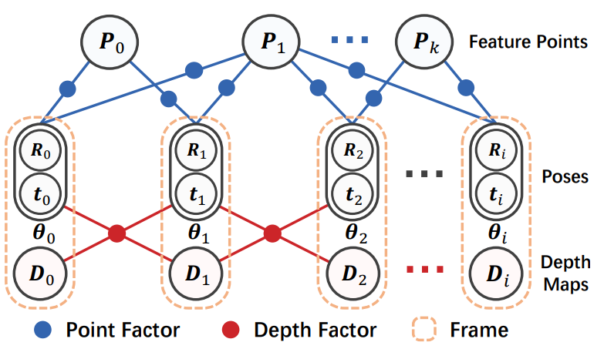
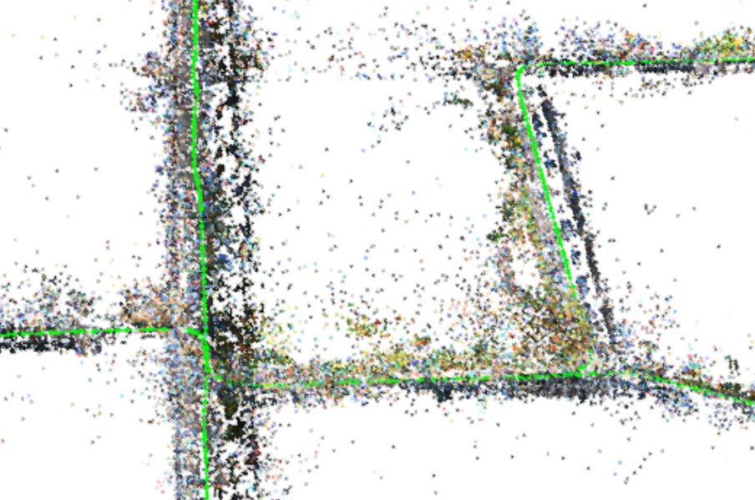
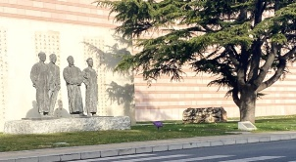

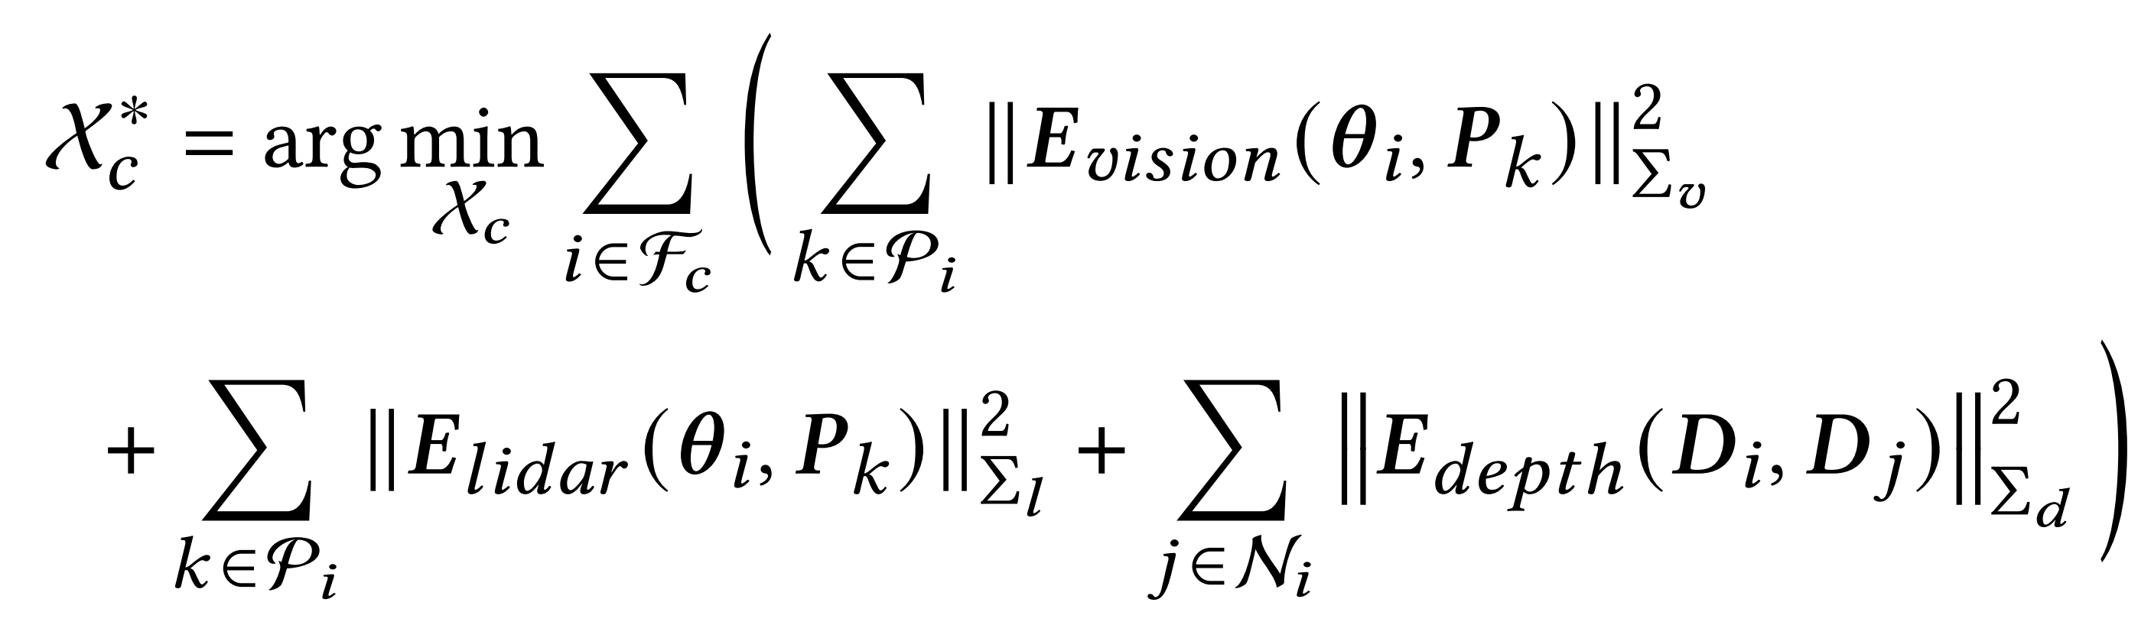

















Learning-embedded Motion Aware Optimization Scheme
Factor-graph based optimization
Consecutive Frames
Learning-embedded
Motion Aware Optimization Scheme
Optimal Results
…
$$P_{0}$$
$$P_{k}$$
Frame $1$
$$θ_{0}$$
$$θ_{1}$$
…
$$θ_{i}$$
Feature Points
$$D_{0}$$
$$D_{1}$$
…
$$D_{i}$$
Frame $2$
Priori
$${\hat{D}}_{1}$$
$${\hat{D}}_{2}$$
…
$${\hat{D}}_{i}$$
Poses
…
Variable Nodes
Factor Nodes
Frame $i$
Depth Map
Refined Depth
Notes:
We first introduce the learning-embedded motion aware optimization scheme.
[Click] Briefly, an optimization takes consecutive visual images, corresponding LiDAR samples, and intermediate depth information extracted from a depth map generator as inputs and then refines the depth of each pixel in the images.
[Click] Here, we use a factor graph to jointly optimize the depth, poses, and feature points. The factor graph consists of two types of nodes: variable nodes indicate the values to be optimized, while factor nodes represent the probability relationship between two variable nodes, the point factor associating pose with feature point, and the depth factor associating adjacent poses and depth maps.
[Click] We optimize all variable nodes simultaneously to obtain globally optimal results. Then we describe the measurements and residuals of two types of point factors, followed by the depth factor.

Slide 9
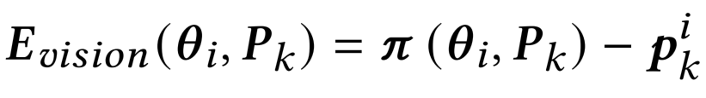


























Learning-embedded Motion Aware Optimization Scheme
Point Factor with Visual Reprojection Error
3D Spatial Point:
$P_{k}$
…
$$I_{j}$$
$$I_{i}$$
$$P_{0}$$
$$P_{1}$$
$$P_{k}$$
Feature Points
$$p_{k}^{j}$$
Observation
$$p_{k}^{i}$$
$$θ_{0}$$
$$θ_{1}$$
$$θ_{2}$$
$$θ_{i}$$
$$π(θ_{i},P_{k})$$
$$R_{0}$$
$$R_{1}$$
$$R_{2}$$
…
$$R_{i}$$
Reprojection
Poses
$$O_{j}$$
$$O_{i}$$
$$t_{0}$$
$$t_{1}$$
$$t_{2}$$
$$t_{i}$$
$$θ_{j}$$
$$θ_{i}$$
Camera Motion:
$$T_{ij}=\left\{R_{ij}, t_{ij}\right\}$$
Point Factor
Frame
Notes:
To optimize the vehicle’s poses and feature points, we first analyze the observation of the environment by the camera.
[Click] Given a triangulated spatial point P_k in previous frames, we can find a corresponding detection on the current image plane.
[Click] We can also re-project the P_k to the current view, and the residual at pose $θ_{i}$ for feature point P_k can be formulated as follows.
[Click] This point factor measures the difference between the pixel location of the observed feature point and the re-projection location of the triangulated 3D point.

Slide 10
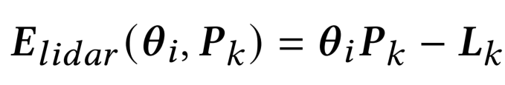







Learning-embedded Motion Aware Optimization Scheme
Point Factor with LiDAR Constraint
3D LiDAR Point
3D Feature Point
$L_{k}$
3D Feature Point
$P_{k}$
$$D_{i}$$
$P_{k}$
…
$$P_{0}$$
$$P_{1}$$
$$P_{k}$$
Feature Points
$$I_{i}$$
$$p_{k}^{i}$$
LiDAR scan trajectory
$$θ_{0}$$
$$θ_{1}$$
$$θ_{2}$$
$$θ_{i}$$
$$R_{0}$$
$$R_{1}$$
$$R_{2}$$
…
$$R_{i}$$
Poses
$$t_{0}$$
$$t_{1}$$
$$t_{2}$$
$$t_{i}$$
$$O_{i}$$
Point Factor
Frame
Notes:
To take full advantage of the fusion of vision and LiDAR sensing modalities, we also optimize the feature points using LiDAR’s overlapping field-of-view to provide depth estimates.
[Click] We first project all the 3D LiDAR points between time t_c and t_(c+1) onto the image plane, and find the one closest to the feature point, and the residual is computed as follows.
[Click] This point factor punishes deviation of the feature point’s depth from the LiDAR observation, optimizing the feature points and vehicle’s pose while applying scale to visual measurements.

Slide 11
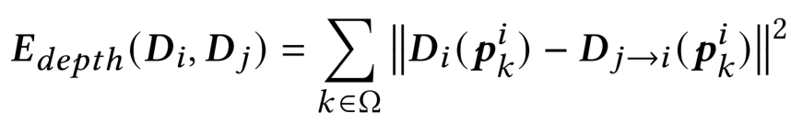




























Learning-embedded Motion Aware Optimization Scheme
Warped Depth
Depth Factor with Geometric Consistency
Current Depth
$$D_{j→i}(p_{k}^{i})$$
$$D_{i}(p_{k}^{i})$$
$$D_{i}$$
$$D_{j}$$
$$I_{i}$$
$$I_{j}$$
$$p_{k}^{i}$$
$$θ_{0}$$
$$θ_{1}$$
$$θ_{2}$$
$$θ_{i}$$
$$p_{k}^{i→j}$$
$$R_{0}$$
$$R_{1}$$
$$R_{2}$$
…
$$R_{i}$$
Poses
$$t_{0}$$
$$t_{1}$$
$$t_{2}$$
$$t_{i}$$
$$O_{i}$$
$$O_{j}$$
$$θ_{i}$$
$$θ_{j}$$
…
Depth
Maps
Camera Motion:
$$T_{ij}=\left\{R_{ij}, t_{ij}\right\}$$
$$D_{0}$$
$$D_{1}$$
$$D_{2}$$
$$D_{i}$$
Warp
Depth Factor
Frame
$$D_{j→i}$$
$$D_{j}$$
Notes:
To fully exploit the capabilities of the depth map from the generator and further optimize the scene depth in a fine-grained manner, we adopt the geometric consistency of the scene depth from different views as a constraint.
[Click] Given a current depth map D_i, we can project D_j to the view of $θ_{i}$, based on the relative pose transformation T_ij.
[Click] When the sampling interval between two consecutive frames is short, the observations of the scene from different views should be consistent. Consequently, the residual between depth maps can be formulated as follows.
[Click] This depth factor constraints the depth map of adjacent frames based on the consistency of the scene geometry in different views, ensuring the continuity and consistency of the depth maps estimated from moving vehicle.

Slide 12
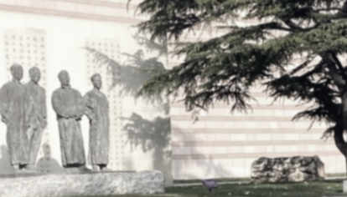






Motion-optical Flow Instructed Self-supervised Framework
Supervision Signals From Motion
Current Image $I_{i}$ & LiDAR Points
Depth Map Generator
Depth Map $D_{i}$
$$T_{ij}$$
Nearby Image $I_{j}$
Warped Image $I_{j→i}$
Motion Information
Notes:
To ease the ground truth annotation costs for training the depth map generator, we design a self-supervised framework. Our solution could automatically extract supervision signals to train the DNN by leveraging the camera’s motion information.
[Click] As seen, given the current image, Nearby Image, the depth map output from the generator, as well as the inter-frame motion acquired from the previous optimization scheme.
[Click] We can inversely wrap the nearby image to the view of the current one and generate a warped image.
[Click and wait]

Slide 13
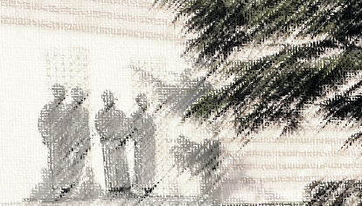




Motion-optical Flow Instructed Self-supervised Framework
Supervision Signals From Motion
Self-Supervised
Training Signal
$I_{i}$
Depth Map Generator
$$L_{p}$$
Current Image $I_{i}$ & LiDAR Points
Depth Map $D_{i}$
Photometric
Consistency
$I_{j→i}$
$$T_{ij}$$
Nearby Image $I_{j}$
Warped Image $I_{j→i}$
Notes:
The pixel-level photometric differences between the current image and the warped image could be served as supervision signals.
However, the above photometric reprojection formulation implies the static-rigid world assumption, but the real environments with high dynamics hardly satisfy this assumption, which eventually degrades the self-supervised training performance.

Slide 14











Motion-optical Flow Instructed Self-supervised Framework
Motion-Optical Flow Constraint
Static Object
3D Spatial Point:
$P_{k}$
$$I_{j}$$
$$I_{i}$$
$$p_{k}^{j}$$
$$p_{k}^{j}$$
Epipolar Line
$$T_{ij}$$
$$O_{j}$$
$$O_{i}$$
$$θ_{j}$$
$$θ_{i}$$
Camera Motion:
$$T_{ij}=\left\{R_{ij}, t_{ij}\right\}$$
Notes:
To improve the robustness of self-supervised training with photometric consistency, we propose a motion-optical flow consistency constraint. The key idea behind this constraint is to select pixels whose associated spatial points meet the static-rigid world assumption for training.
[Click] From the perspective of geometrics, for a static object, its projection on the nearby frame should fall on the epipolar line.
[Click and wait]

Slide 15
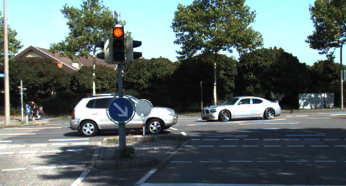
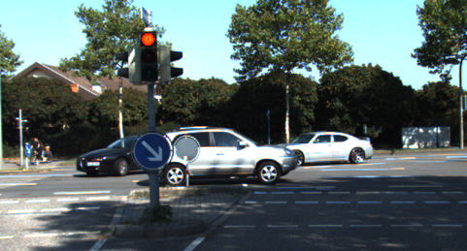










Motion-optical Flow Instructed Self-supervised Framework
Motion-Optical Flow Constraint
Moving
3D Spatial Point:
$P_{k}$
$$I_{j}$$
$$I_{i}$$
$$p_{k}^{j}$$
$$p_{k}^{j}$$
$$T_{ij}$$
$$O_{j}$$
$$O_{i}$$
$$θ_{j}$$
$$θ_{i}$$
Moving Object
Camera Motion:
$$T_{ij}=\left\{R_{ij}, t_{ij}\right\}$$
Notes:
Then we consider the case where the assumptions are not satisfied, as shown, the projection of the moving object in the next frame is difficult to fall exactly on the epipolar line.
Therefore, we can filter the unreasonable pixels based on the above geometric constraints by calculating the optical flow field between adjacent frames.

Slide 16

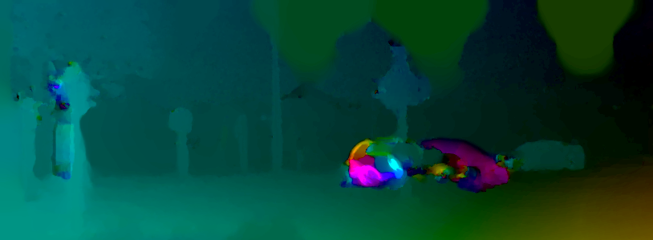






Motion-optical Flow Instructed Self-supervised Framework
Motion-Optical Flow Constraint
Qualitative Results of Filtering: reflection, occlusion, and movement.
Occlusion
Non-Lambertian Surface
Occlusion
Non-Lambertian Surface
Moving Objects
Moving Objects
Optical Flow
Optical Flow
Reflective Surface
Dynamic Objects
Consecutive Frames
Noise Filtering
Notes:
We show two complicated real-world scenarios that severely impact self-supervised training, The left figures show consecutive frames collected during the vehicle’s movement. The top right figure shows the visualized optical flow between two frames, and the last figure depicts the generated confidence masks. Pixels that lie in the darker region will be filtered out and not be leveraged to train the DNN.
[Click] The qualitative results demonstrate the ability of LeoVR to effectively filter reflection, occlusion, and movement.

Slide 17














Motion-optical Flow Instructed Self-supervised Framework
Overall Self-supervised Training Loss
$$L_{f}$$
…
Feature Points
Constraint
$$P_{0}$$
$$P_{k}$$
Feature Points $D_{i}^{f}$
$$θ_{i}$$
$$θ_{i+1}$$
$$θ_{i+2}$$
Depth Map Generator
$$L_{r}$$
Current Image $I_{i}$
& LiDAR Points
Depth Map ${\hat{D}}_{i}$
Refined Depth
Guidance
$$D_{i}$$
$$D_{i+1}$$
$$D_{i+2}$$
Factor Graph
Based Optimization
Refined Depth $D_{i}^{r}$
$${μL}_{p}$$
$$T_{ij}$$
Photometric
Consistency
Motion-Optical Flow
Consistency Constraint
Nearby Image $I_{j}$
Warped Image $I_{j→i}$
Self-Supervised
Training Loss
Confidence Mask $μ$
Workflow of the motion-optical flow instructed self-supervised framework in LeoVR
Notes:
In addition to the above photometric consistency with motion-optical flow constraint,
[Click] we also take full advantage of the output of the factor-graph optimization framework, including the optimized 3D feature points and refined depth maps for better stability and faster convergence during the model training.

Slide 18



Experiment
Details of Data Collection in Different Scenarios
Architecture of Depth Map Generator
Livox Mid-40 and Velodyne VLP-16
Notes:
As summarized in the table, we conduct experiments in four representative scenarios, city road and campus as outdoor scenarios, while classroom building and office building as indoor scenarios. These scenes enjoy diverse spatial geometric layouts and environmental dynamics and thus provide different challenges for environment depth estimation.
The architecture of our depth map generator follows the classic and lightweight model.

Slide 19





Experiment
Overall Performance
~3cm
>10cm
<20cm
Different Environments
Different LiDARs
<5cm
Generated Depth Map from LeoVR
Self-supervised Methods
System Efficiency
Notes:
We first evaluate the depth estimation performance of LeoVR with four comparative systems.
[Click] As shown, LeoVR achieves the best performance in all scenarios.
[Click] And LeoVR brings significant performance gains when using different types of LiDAR, especially for the commercial yet sparsely sampled Mid-40.
[Click] When cold start in different scenarios without pre-training, LeoVR with self-supervised Learning outperforms comparative approaches by 45%.
[Click] In addition, as a depth estimation system towards auto-driving scenarios, we further evaluate the efficiency of LeoVR.
Unlike existing DNN standalone approaches, LeoVR involves both a model and an optimization scheme. In general, it could work with a frequency of 16Hz, which matches the LiDAR sampling frequency.
Besides, benefiting from our optimization scheme, LeoVR could select a more lightweight model to guarantee real-time performance.

Slide 20

Experiment
System Robustness Evaluation
<60cm
Impact of Distance
Impact of Moving Speed
Impact of Scene Dynamic
Notes:
We also analyze the system’s robustness in the most challenging city road using commercial autonomous vehicles equipped with Livox Mid-40. We evaluate the impact of sensing distance, moving speed, and scene dynamic.
[Click] As the vehicle speed increases, the LiDAR point clouds and visual features suffer from obvious motion blur due to their hardware nature, and we reserve the depth estimation in high-speed as future work.

Slide 21

Experiment
Ablation Study
23.4% Up!
13.1% Up
Optimization Framework
Motion-Optical Flow Constraint
Additional Constraints
Notes:
We then conduct an ablation study to understand the effectiveness of some modules in LeoVR. We evaluate our optimization framework, motion-optical flow constraint, as well as additional constraints.
[Click] As shown in figure 2, the motion-optical flow constraint can improve model performance effectively, especially in dynamic outdoor environments.

Slide 22
Conclusion
We propose LeoVR:
The first self-supervised solution that enables commercial autonomous vehicles to generate accurate depth maps by fusing vision and low-cost LiDAR.
LeoVR pushes forward depth estimation techniques for on-vehicle, low-cost, and large-scale deployments in real environments.
We provide a fresh perspective to embed a vehicle’s motion information into the system framework design:
Design a motion-aware learning-embedded fusing scheme to boost the depth estimation accuracy.
Design a motion-instructed self-supervised framework to ease the pixel-level ground truth annotation burden.
Implement LeoVR on commercial vehicles with low-cost LiDAR.
Notes:
Now, let’s summarize our key contribution.
First, we propose LeoVR, the first self-supervised solution that enables commercial autonomous vehicles to generate accurate depth maps by fusing vision and low-cost LiDAR. LeoVR pushes forward depth estimation techniques for on-vehicle, low-cost, and large-scale deployments in real environments.
Second, we provide a fresh perspective to embed a vehicle’s motion information into the system framework design. Based on the spatio-temporal constraints behind motion information, we design a motion-aware fusion framework and a motion-instructed self-supervised framework.
Finally, we evaluate the performance of LeoVR with 4 comparison works in 4 different scenarios across 6 months. The results demonstrate that LeoVR could greatly broaden the capabilities of depth estimation even with low-cost LiDARs.

Slide 23
Thanks!
Q&A

